Slide 1
What is Chemical Transport Modeling?

Slide 2
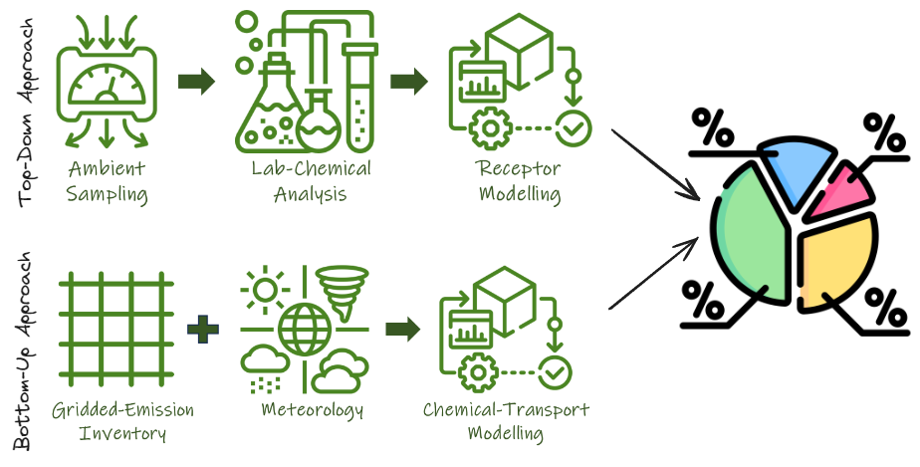
Two Approaches

Slide 3
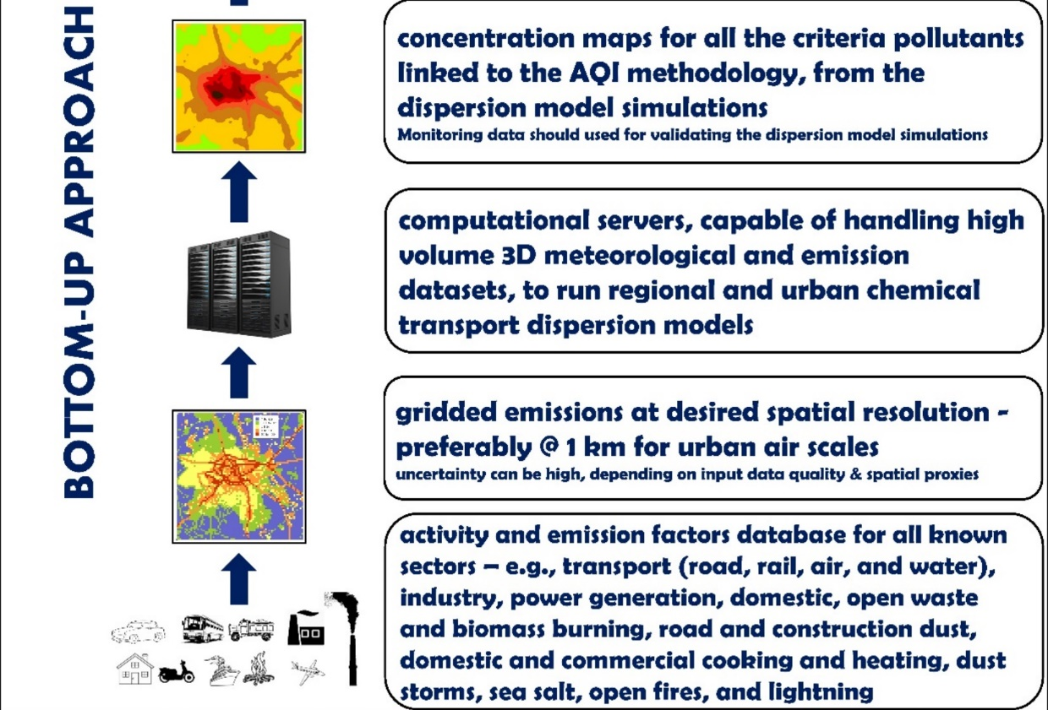


Slide 4
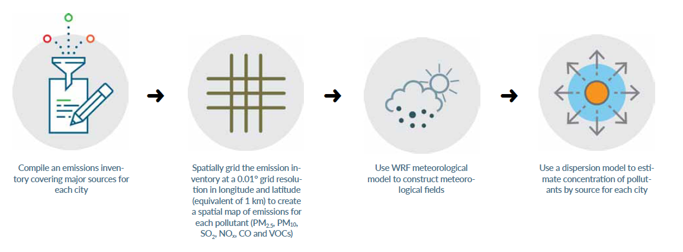
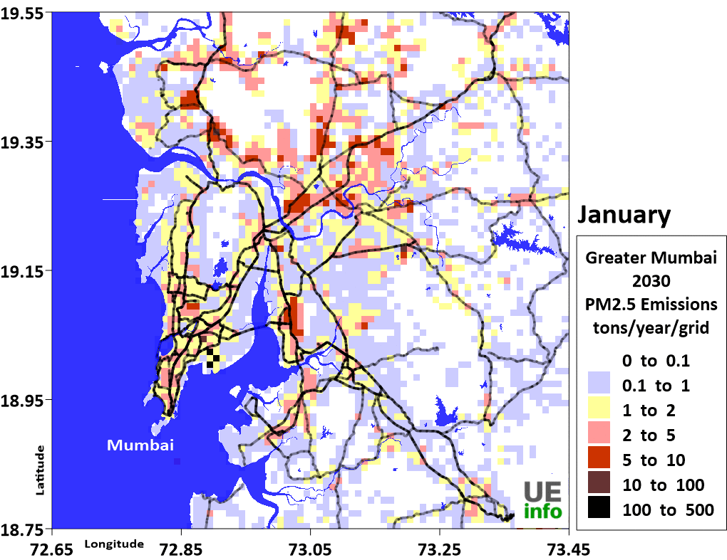
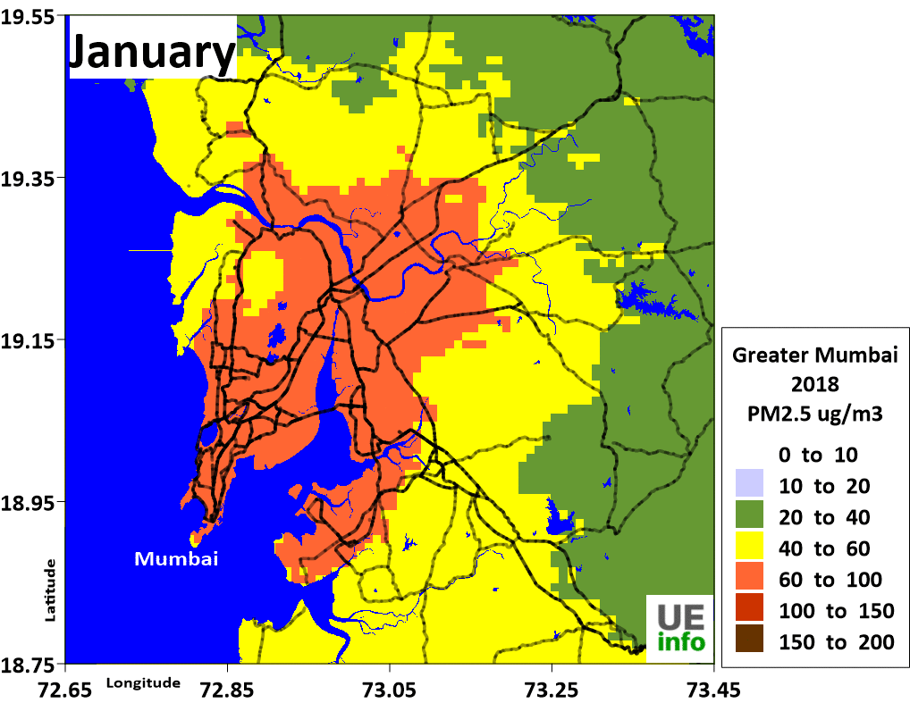
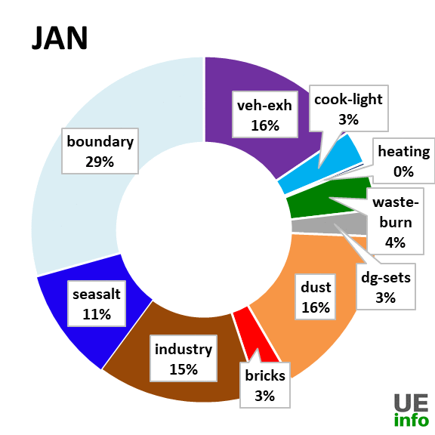
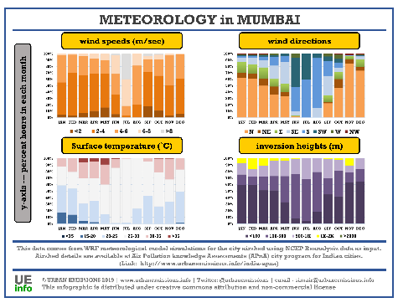
Air quality Analysis is data intensive and technically challenging
inputs
Mumbai, India

Slide 5
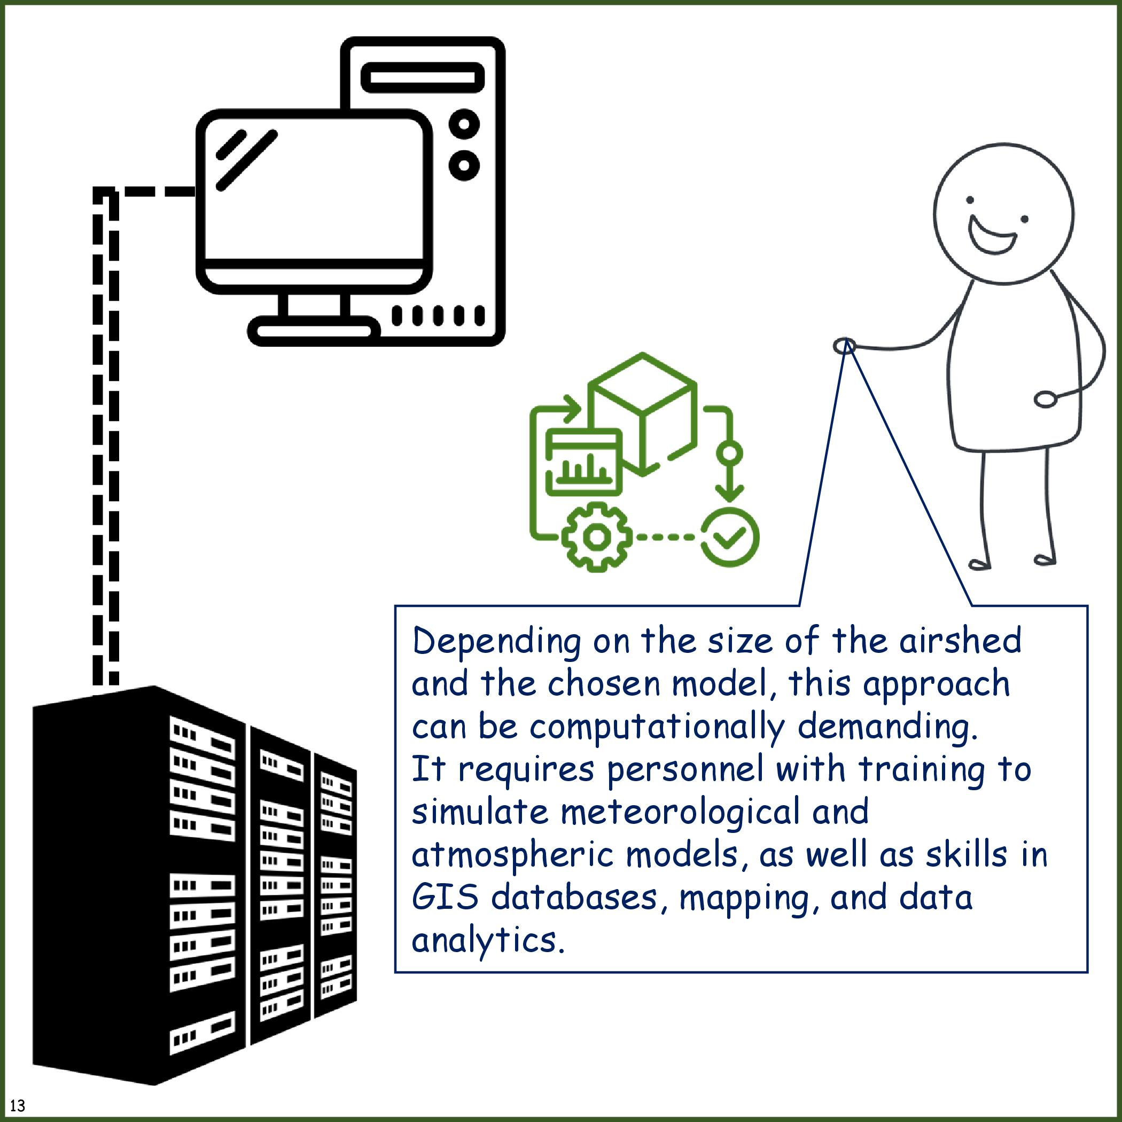

Slide 6



Principles of Dispersion (Advection)
Dispersion
+
Chemistry
Emissions
Wet Deposition
Dry Deposition

Slide 7
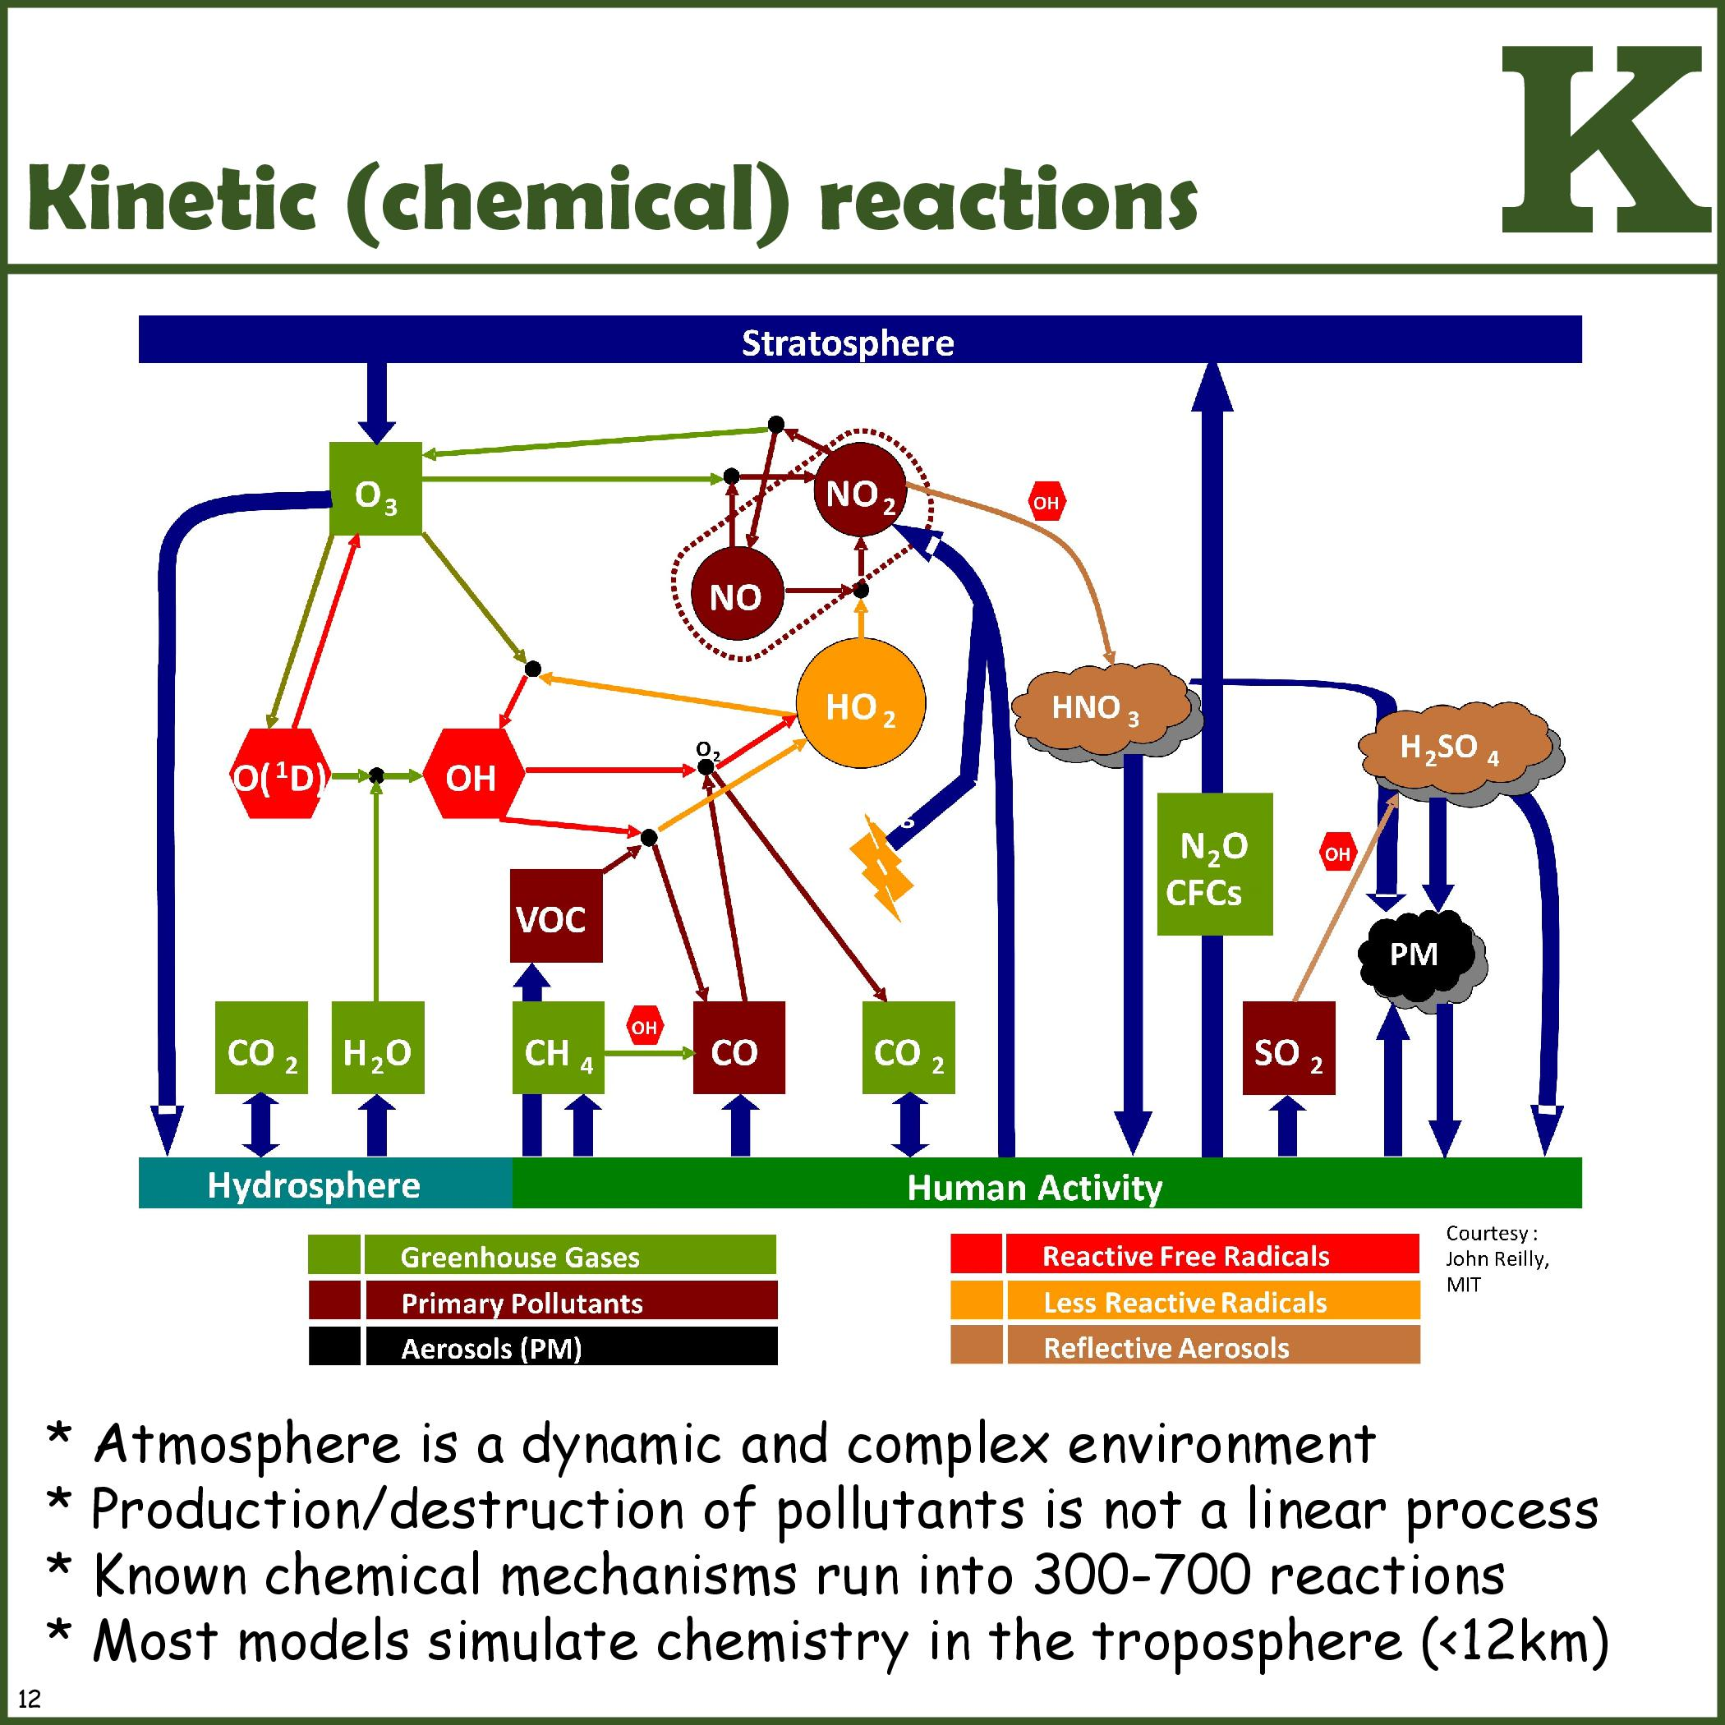

Slide 8
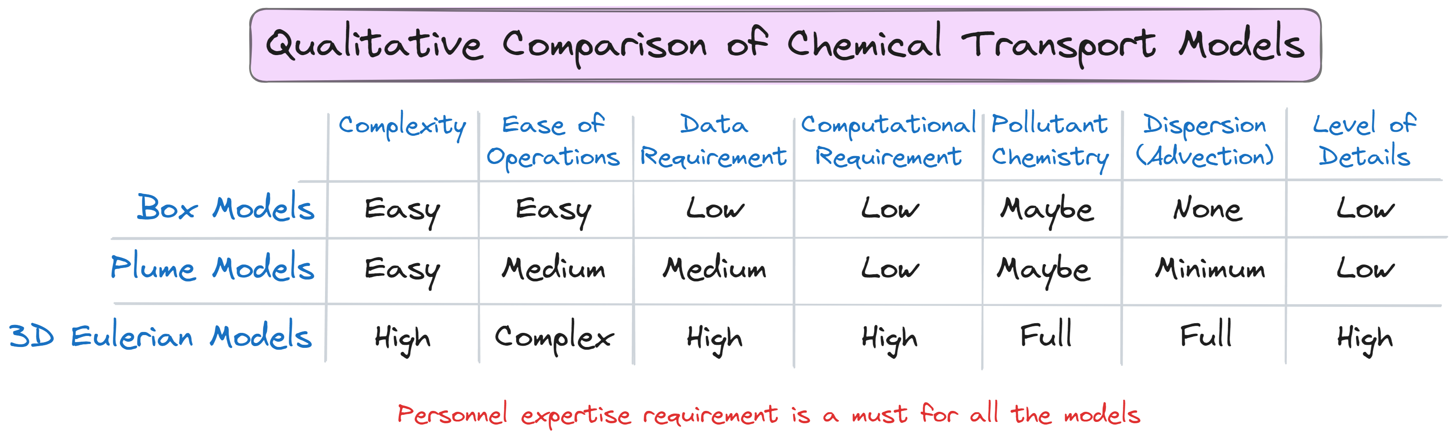

Slide 9
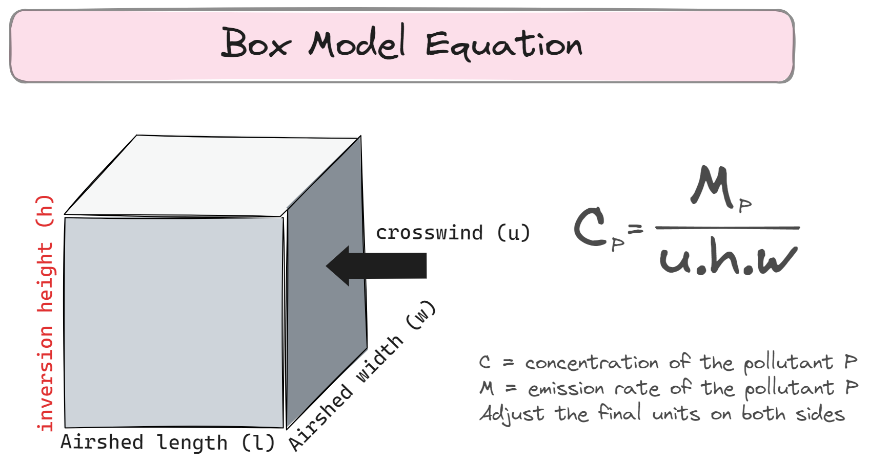

Slide 10
Box Model Demo

Slide 11
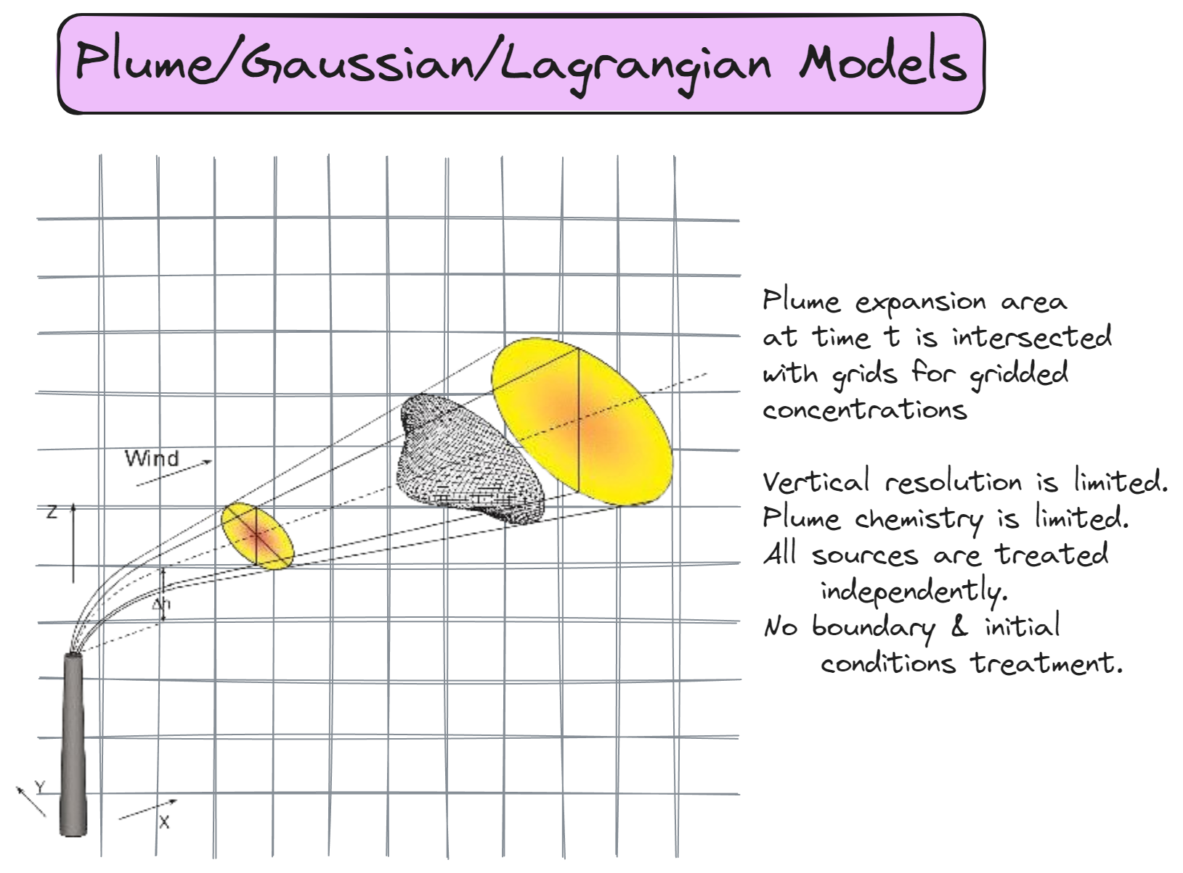

Slide 12
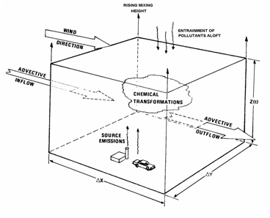
Eulerian Models
Gradient transport or eddy diffusion model based on the mass balance around a differential volume.

Slide 13
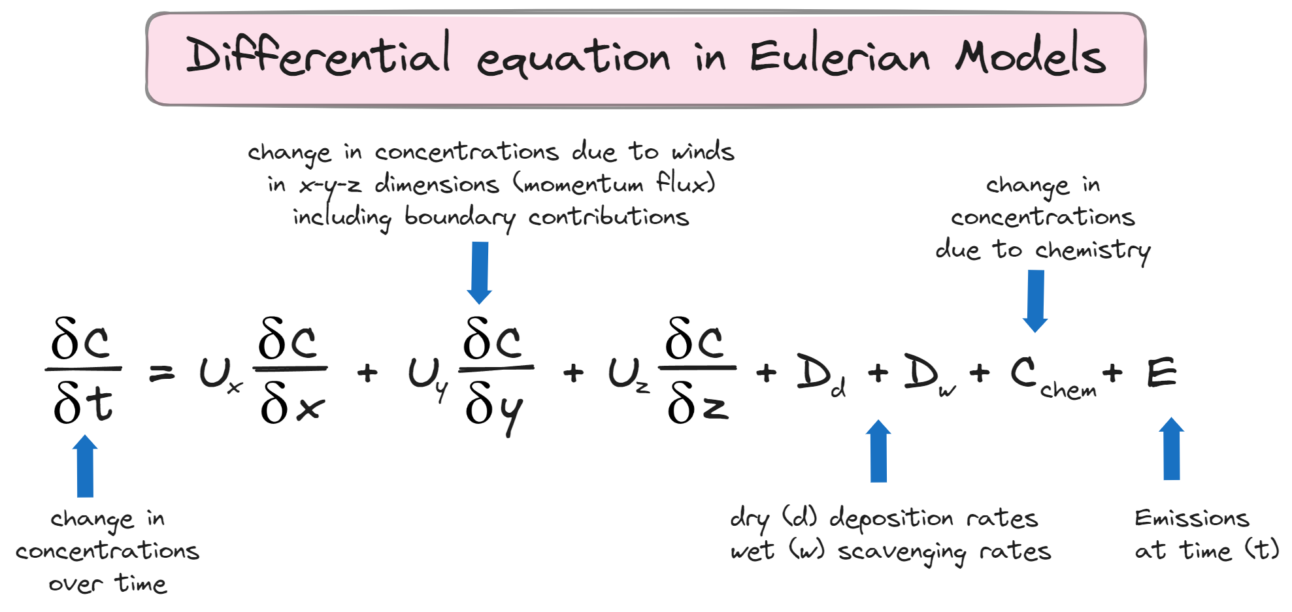

Slide 14
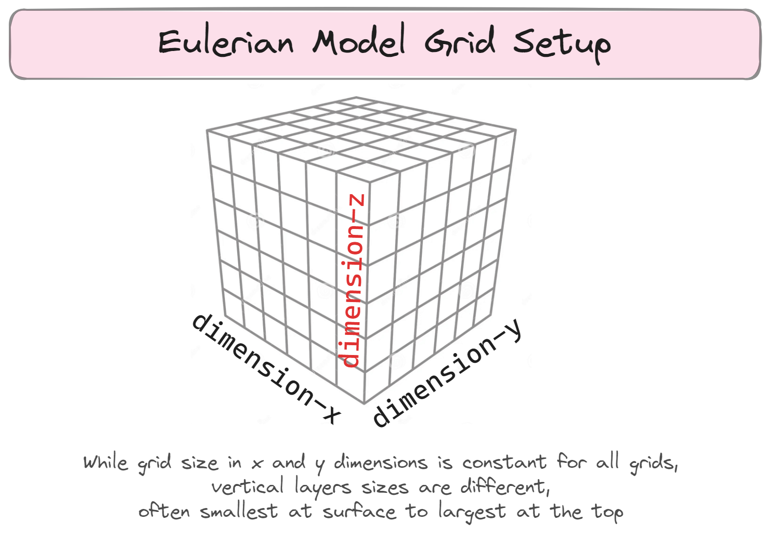

Slide 15
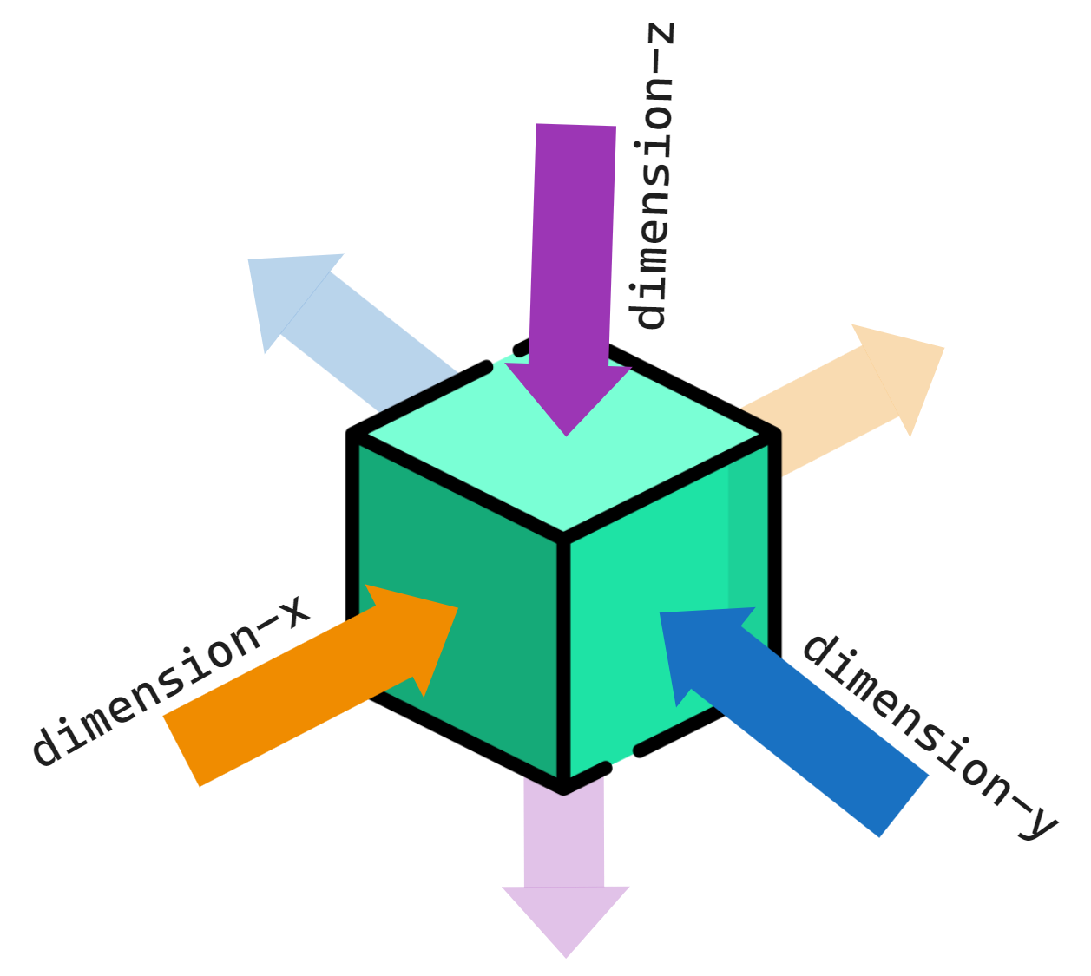

Slide 16
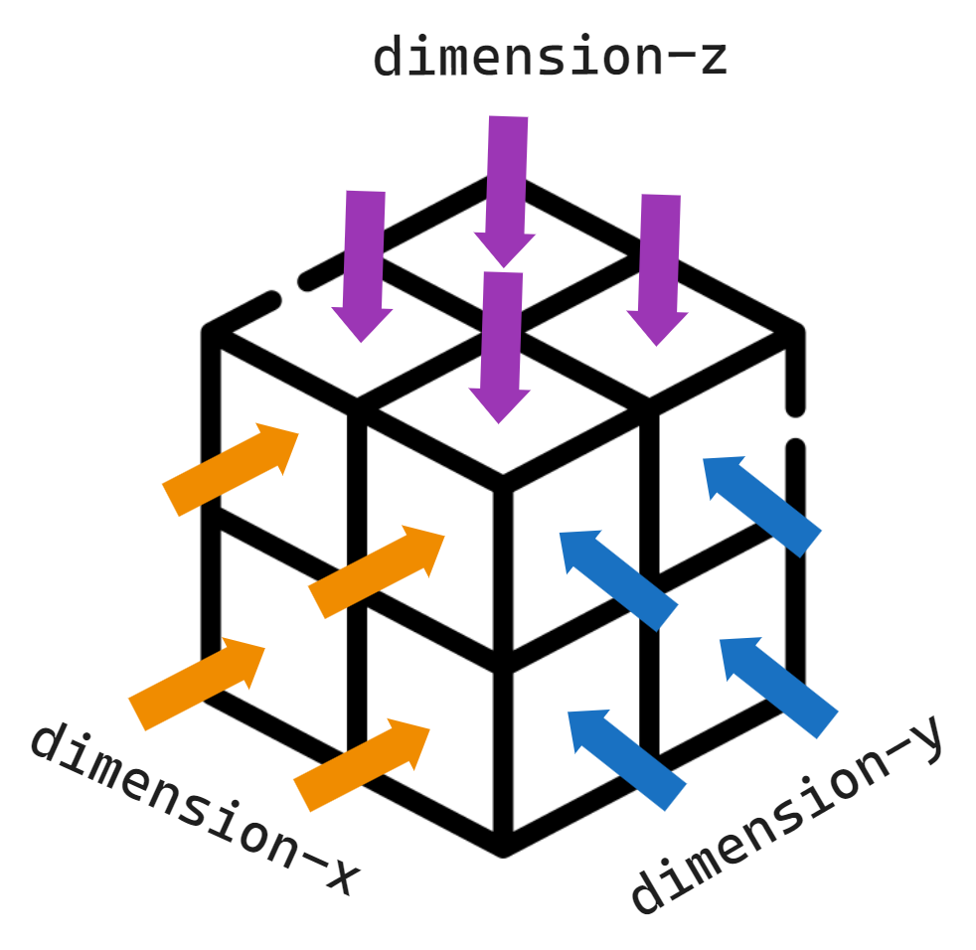

Slide 17
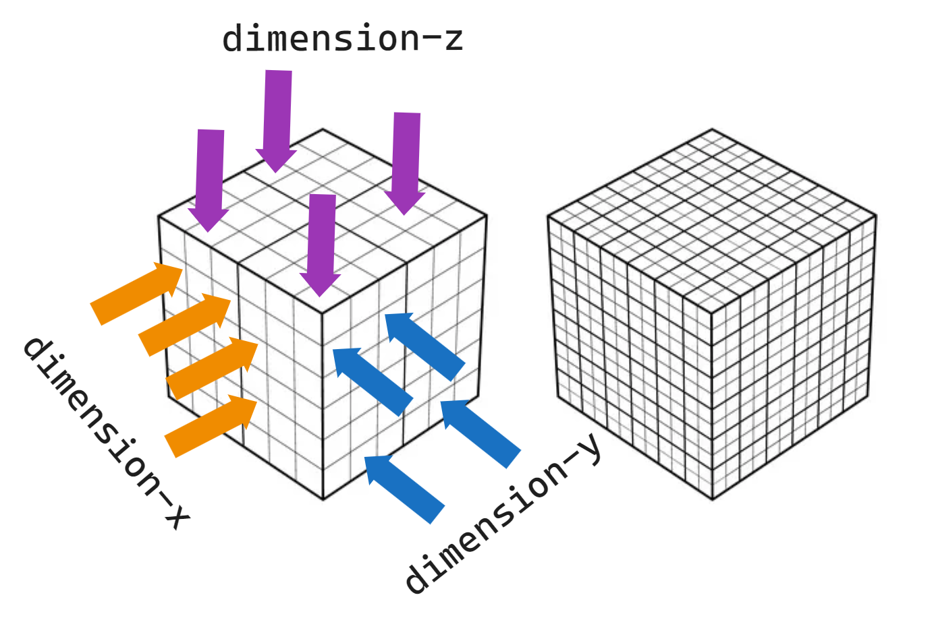

Slide 18
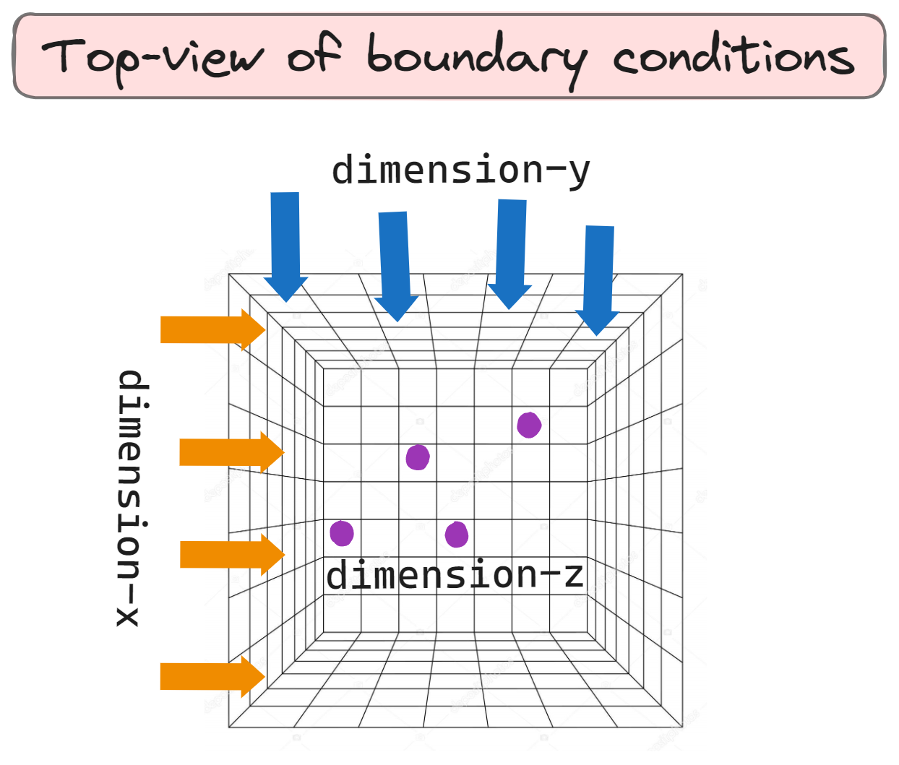

Slide 19
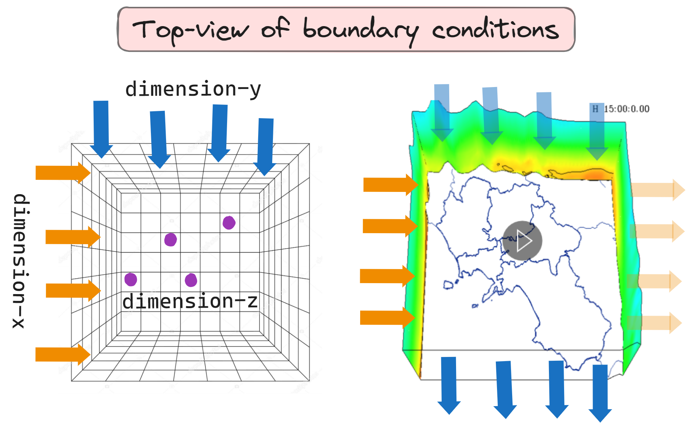

Slide 20
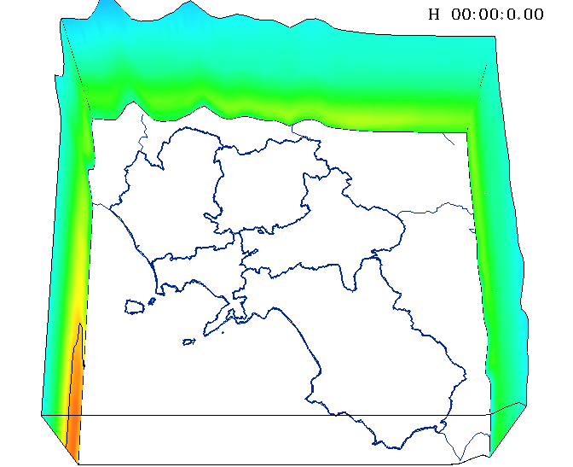
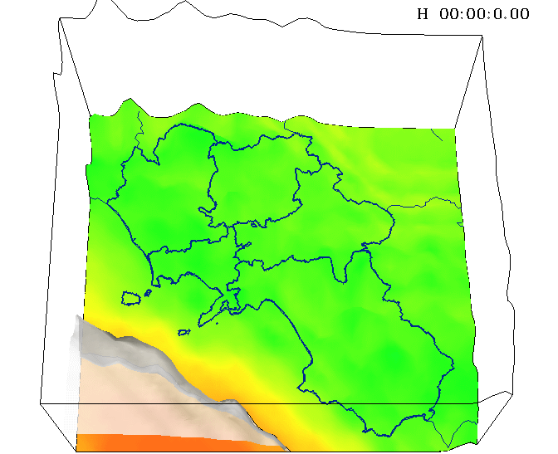
Boundary & Initial Conditions
Initial Conditions

Slide 21

Boundary for Global Simulations
Initial Conditions

Slide 22
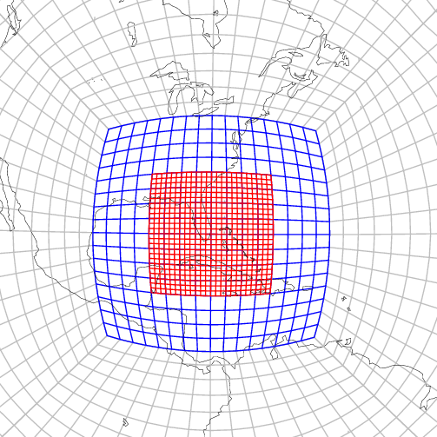
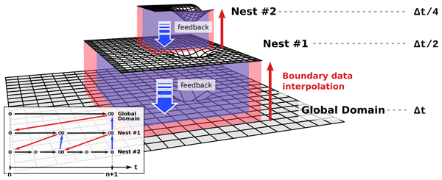
Grid Nesting

Slide 23
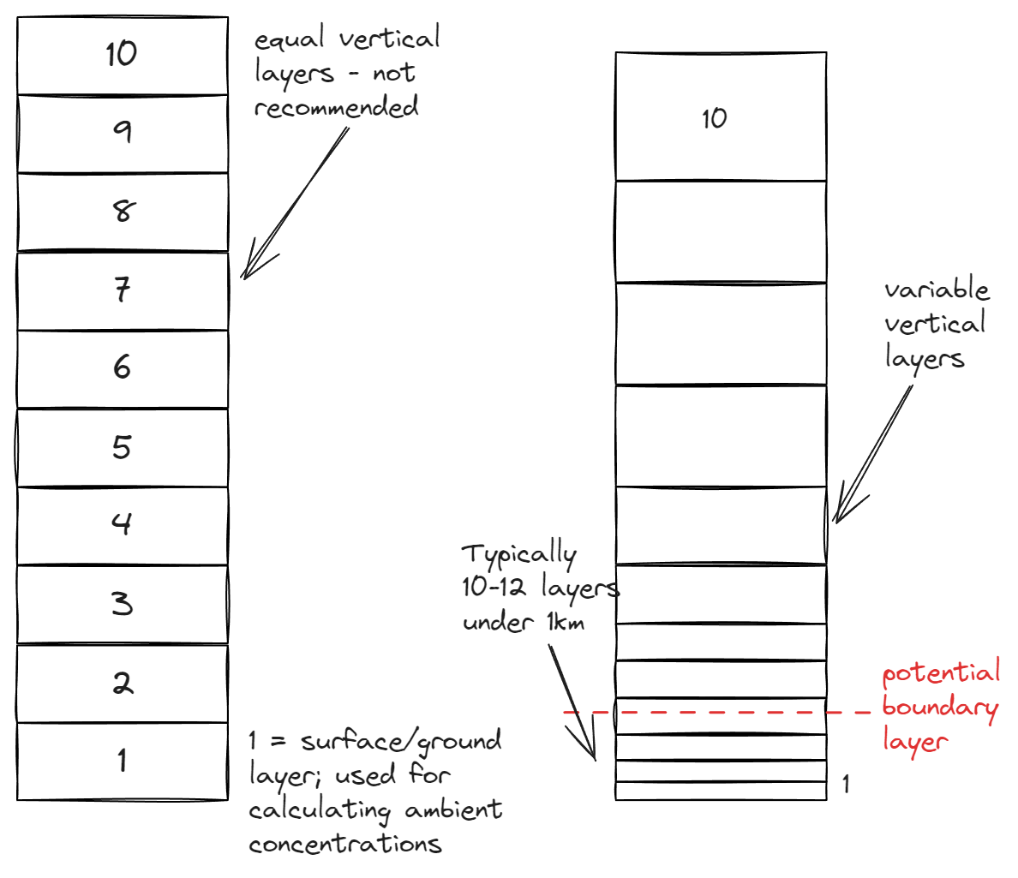
Vertical Layers

Slide 24
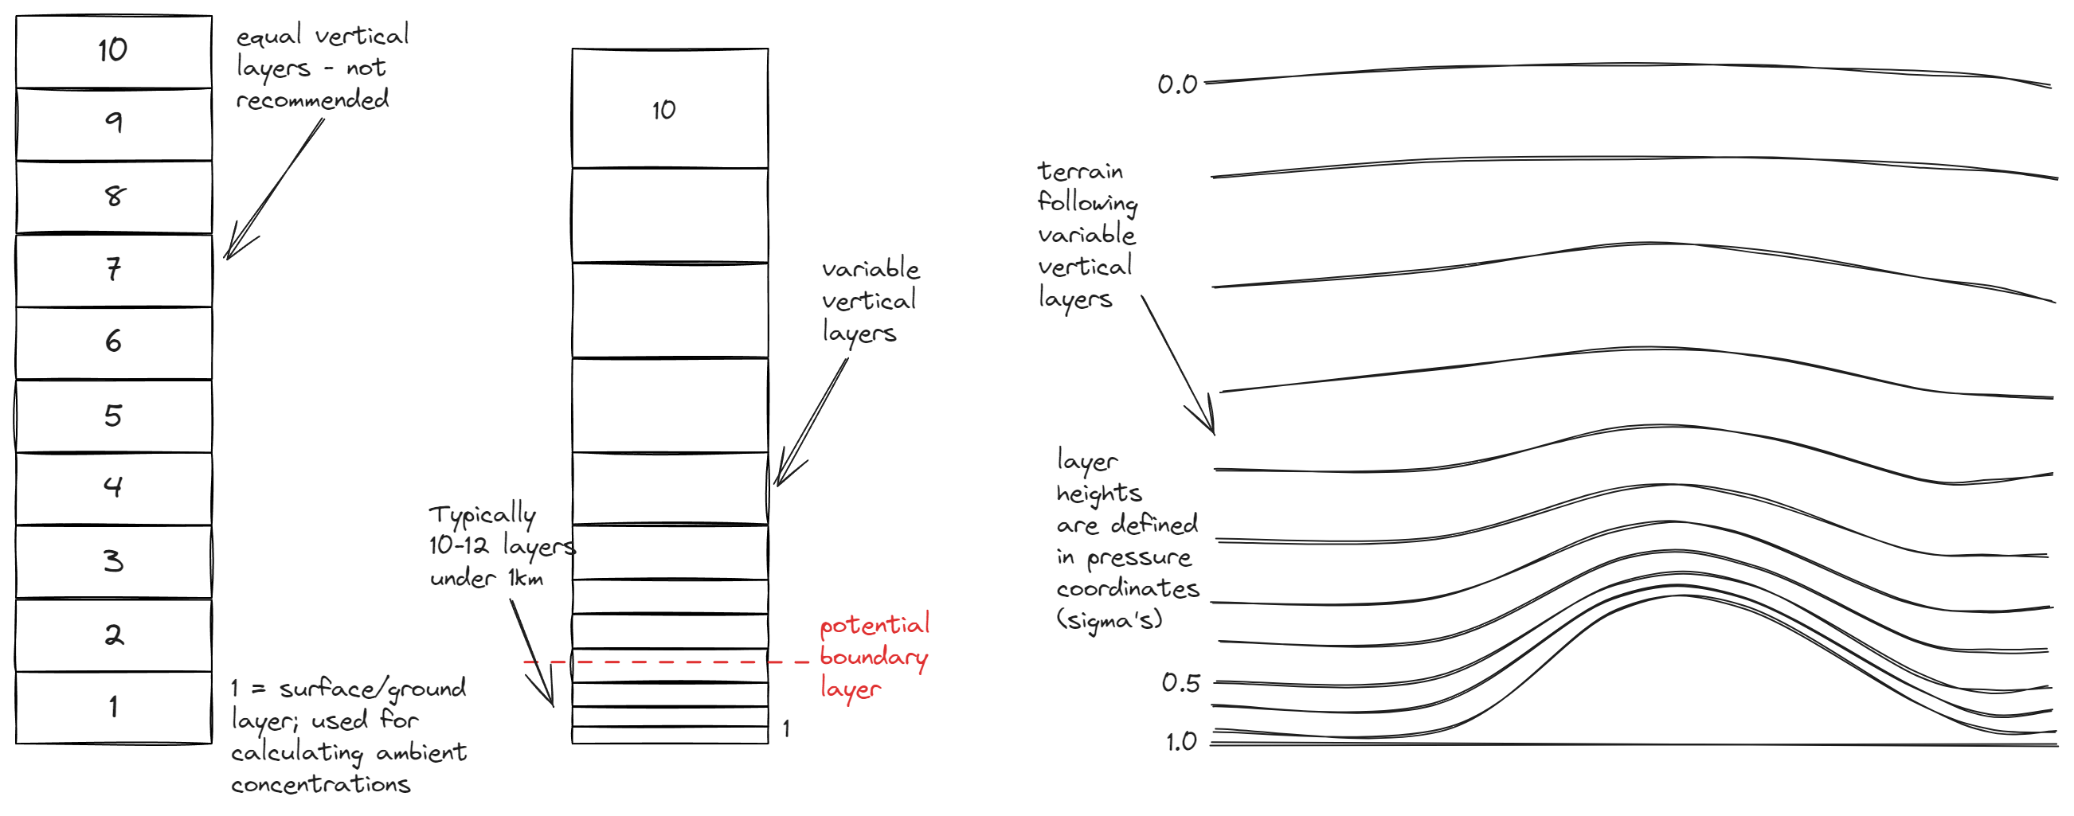
Vertical Layers

Slide 25
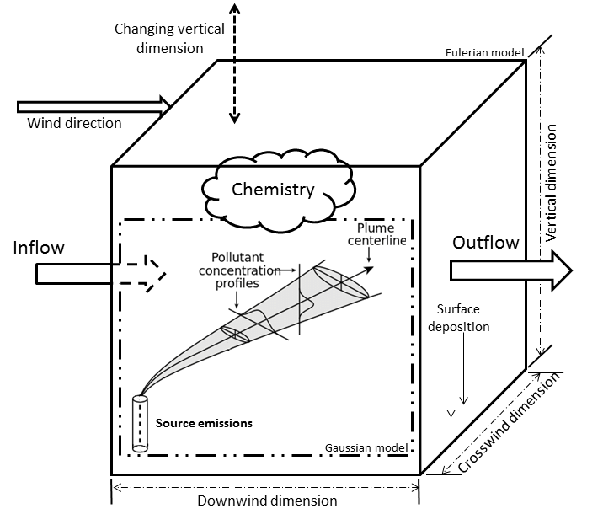
Difference between Gaussian & Eulerian Systems

Slide 26
Variety of Models
A combination of models are available
Puff transport models for industrial analysis
  ISC3, ATMOS, ADMS
Urban scale models
  UAM-IV, UrBAT
Regional Chemical Transport models
  STEM, FARM, CMAQ, CAMx
Global transport models
  MOZART, GISS, MATCH

Slide 27


