Slide 1
Designating Airsheds in India for Urban and Regional Air Quality Management

Slide 2
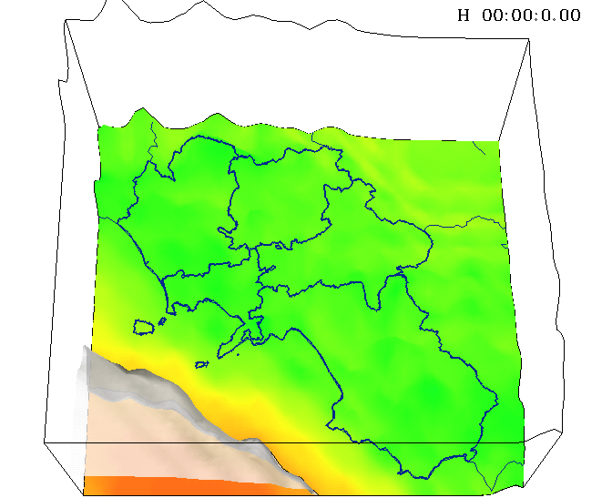
Why we need airsheds?
What’s in the imaginary box?

Slide 3
Why we need airsheds?
We want to know the trends (ranking)
Contribution of sectors
Contributions to each other
Regional coordination

Slide 4
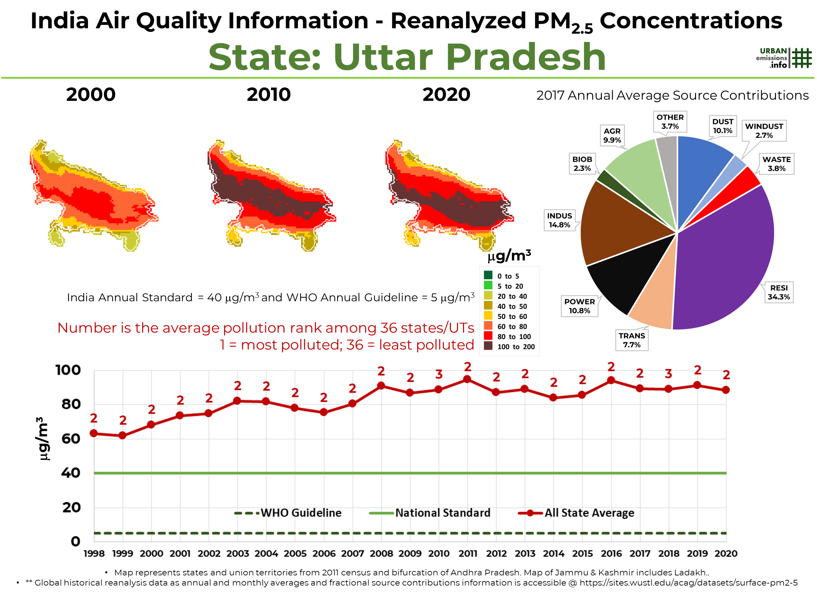
Sectoral contributions
Where we use the airsheds?
Modelling
Spatial contributions
Trends

Slide 5
There is no set definition for “airshed”
… you are working in an area,
that’s your airshed
… pretty much, depends on
“who is asking”

Slide 6
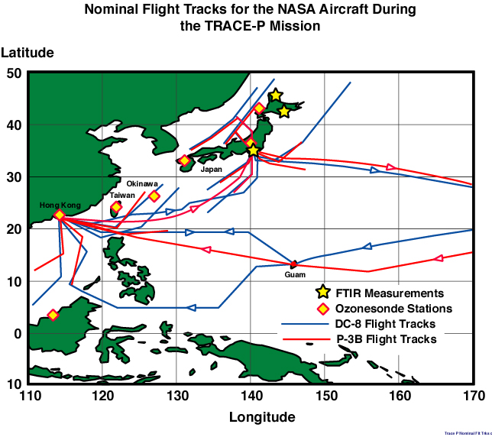
Designating Airsheds – Who is asking?

Slide 7
What are we looking for?
.. a common base
.. for urban and regional coordination,
collaboration, integration
.. of knowledge and efforts

Slide 8
Designating Airsheds – What are we looking for?
Urban
Regional
PM_{2.5} and PM₁₀
SO₂, NO₂, CO, and Ozone
Multi-pollutant plans

Slide 9
How to define the box (airshed)?

Slide 10
Designating Airsheds in India
Mathematical
Modelling
Urban
Governance
Management
Urban/Regional

Slide 11
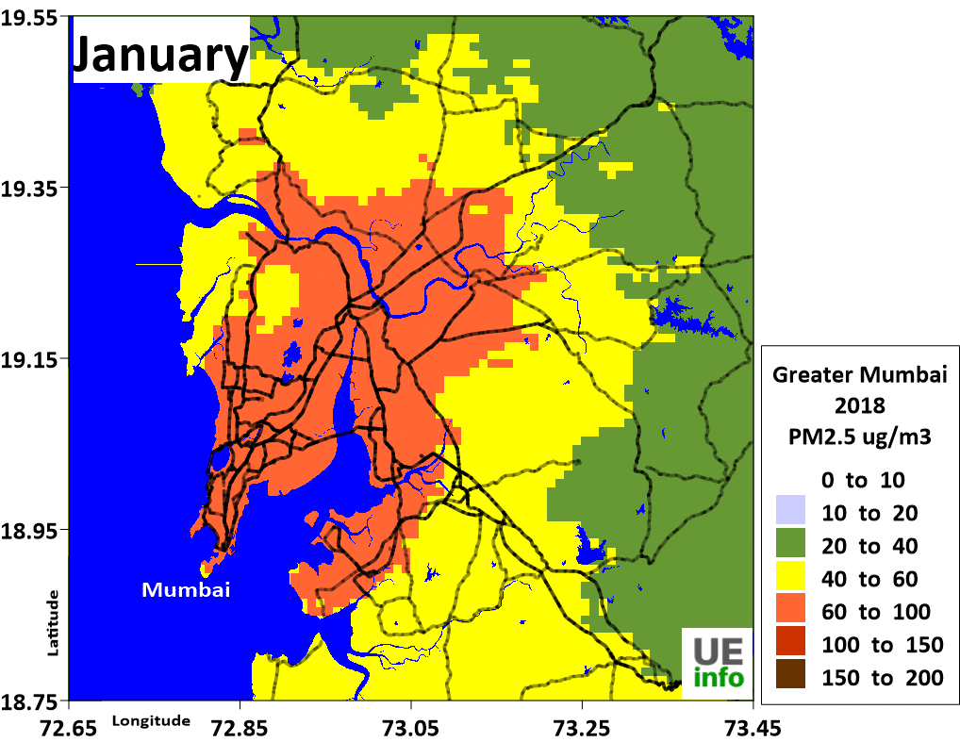
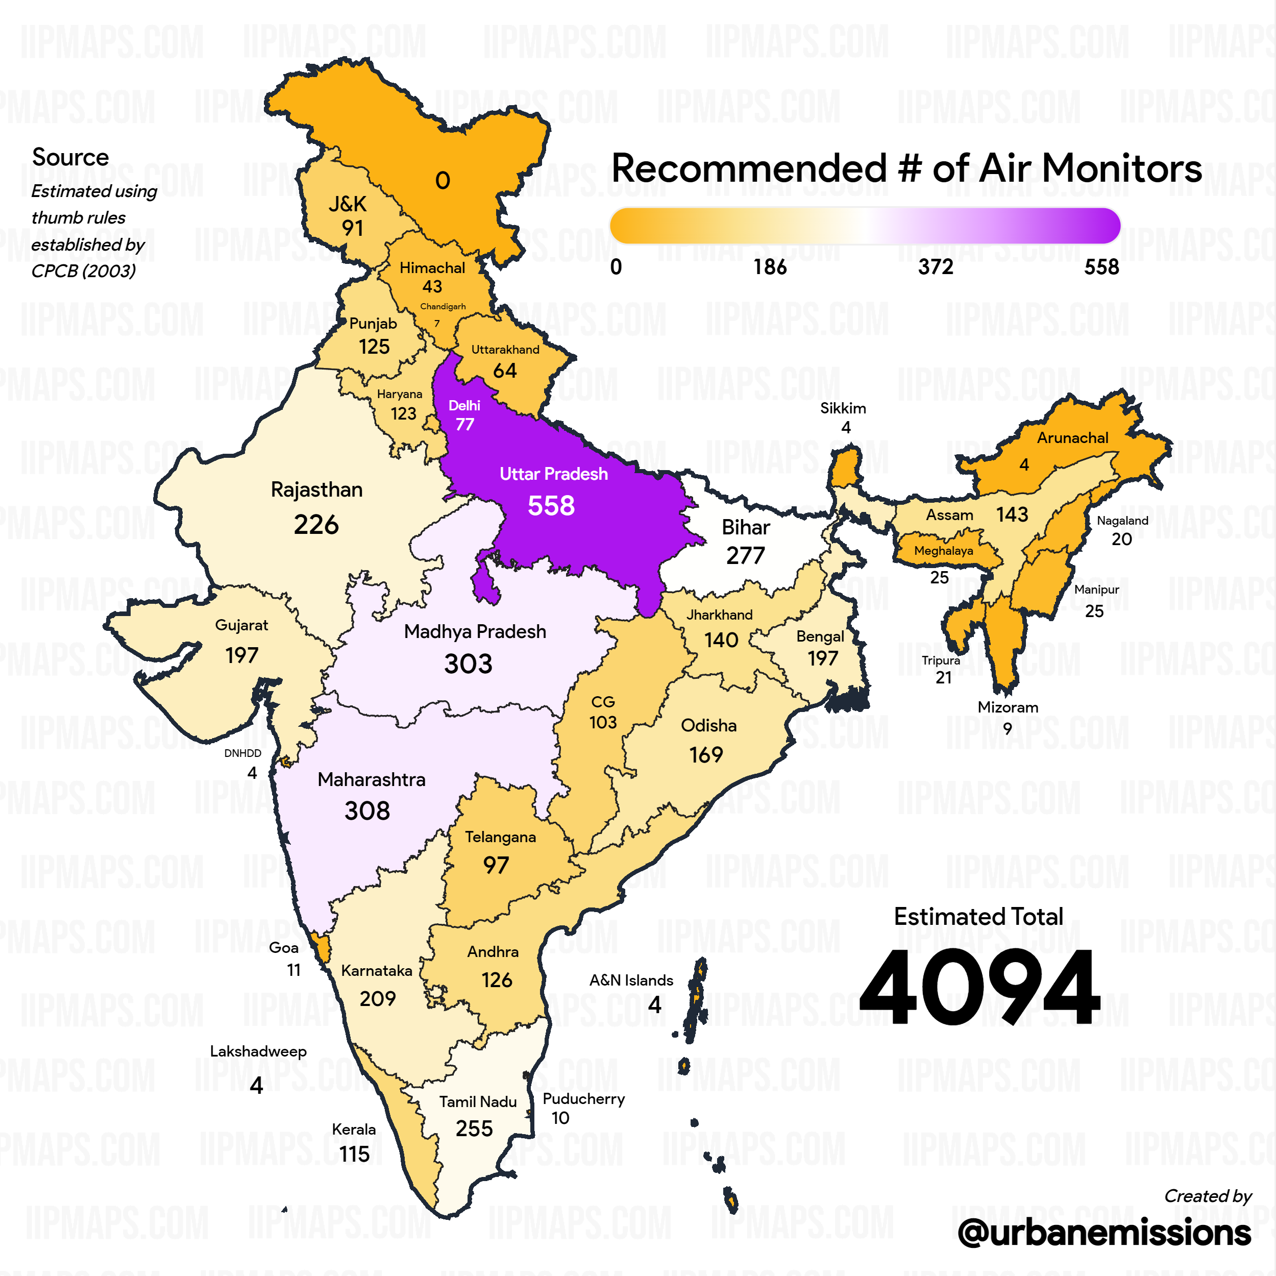
Governance
Urban
Regional
Urban local bodies, Municipalities, and state bodies
State and Central Ministries

Slide 12
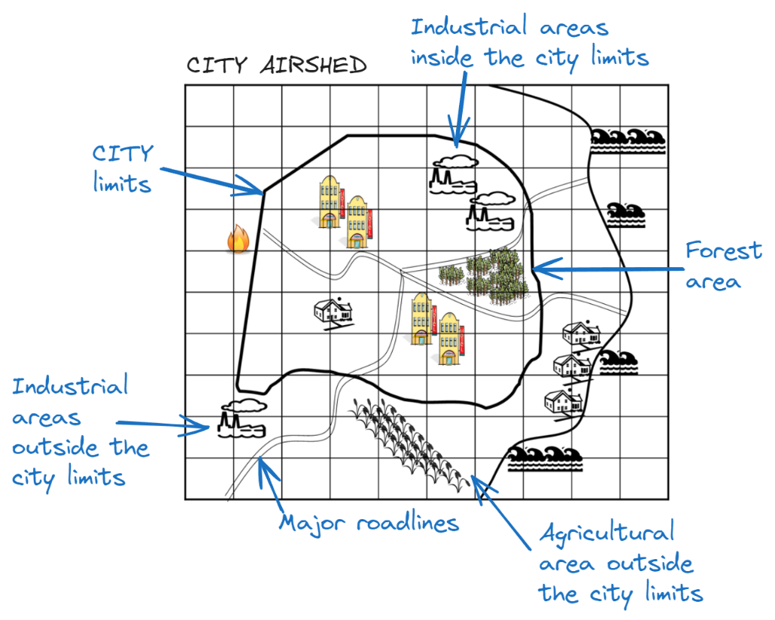
Mathematical (Urban)

Slide 13
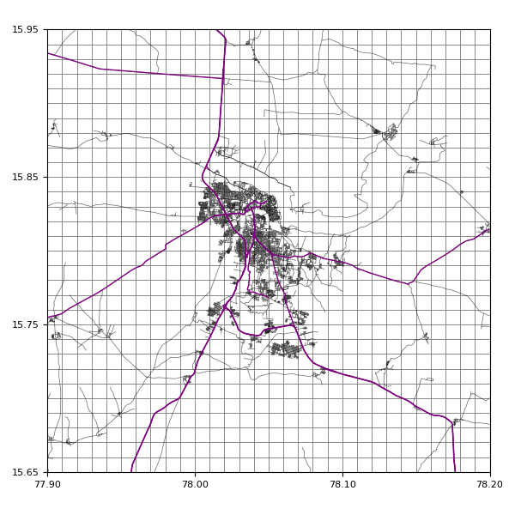
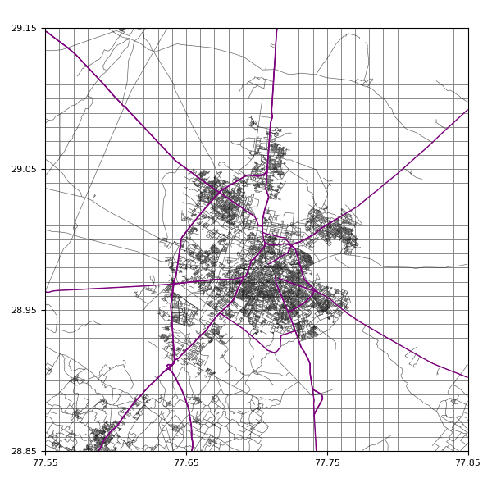
Mathematical (Urban)
Kurnool
Meerut
Kurnool
Meerut
Delhi

Slide 14
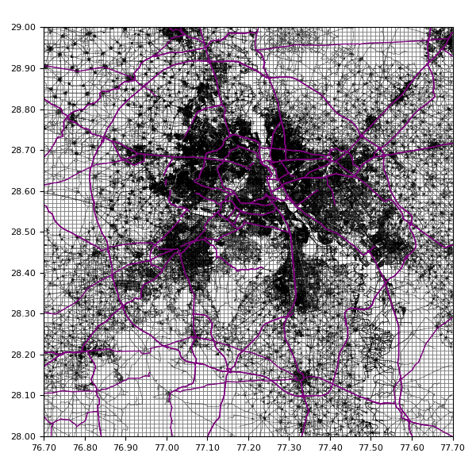
Mathematical (Urban)
Delhi
Meerut
Meerut
Delhi

Slide 15
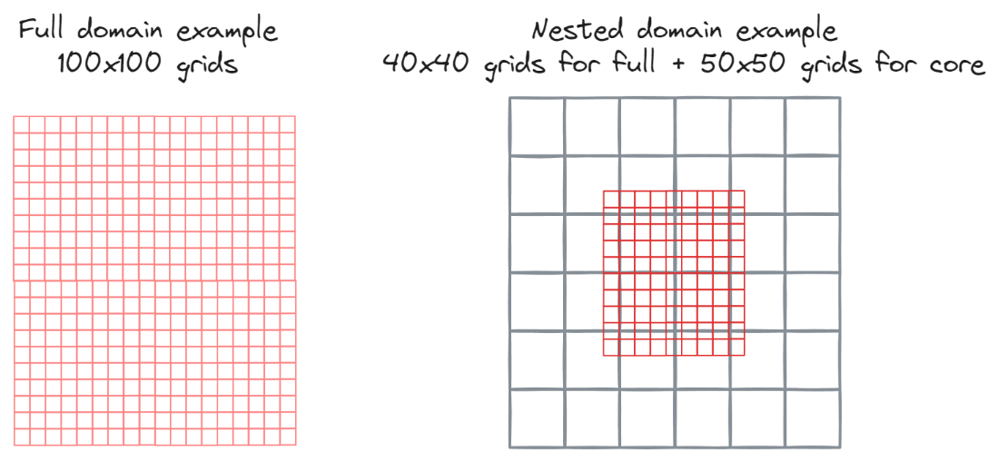
Mathematical + Governance (Semi-Regional)

Slide 16
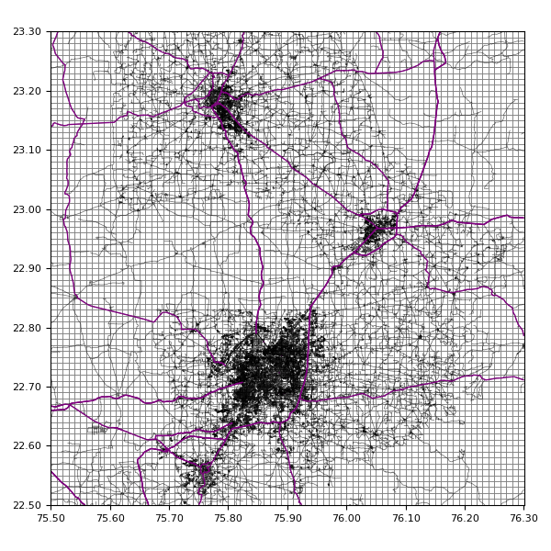
Mathematical (Urban)
Delhi
Indore
Ujjain
Dewas

Slide 17
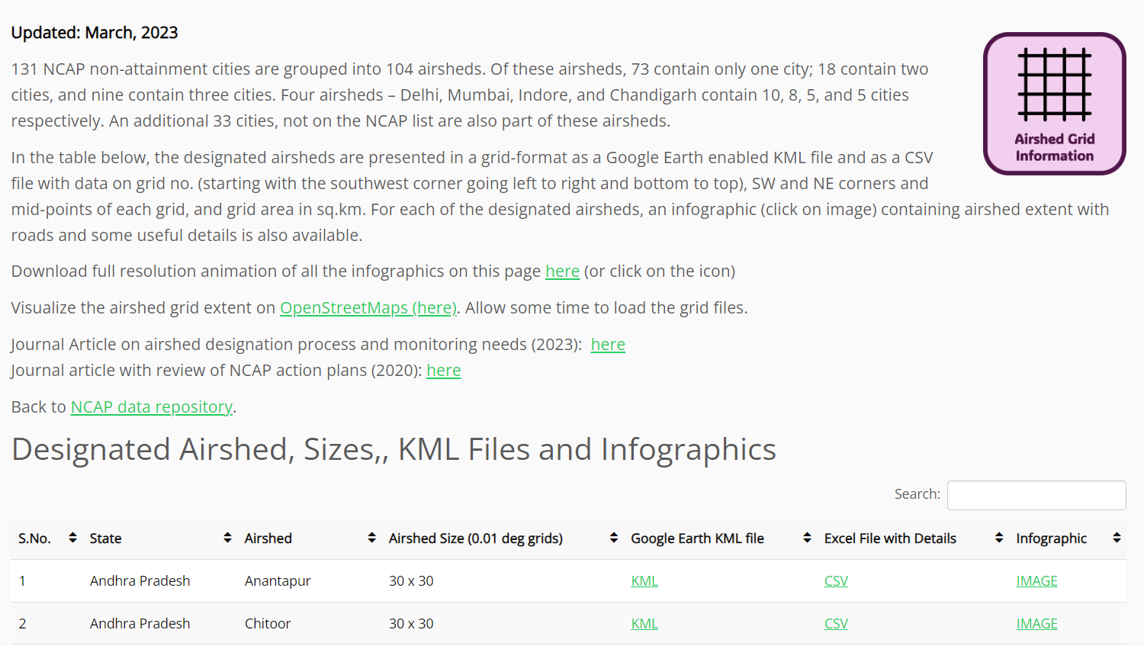
Designated Airsheds for NCAP cities https://urbanemissions.info/india-air-quality/india-ncap-city-airsheds

Slide 18
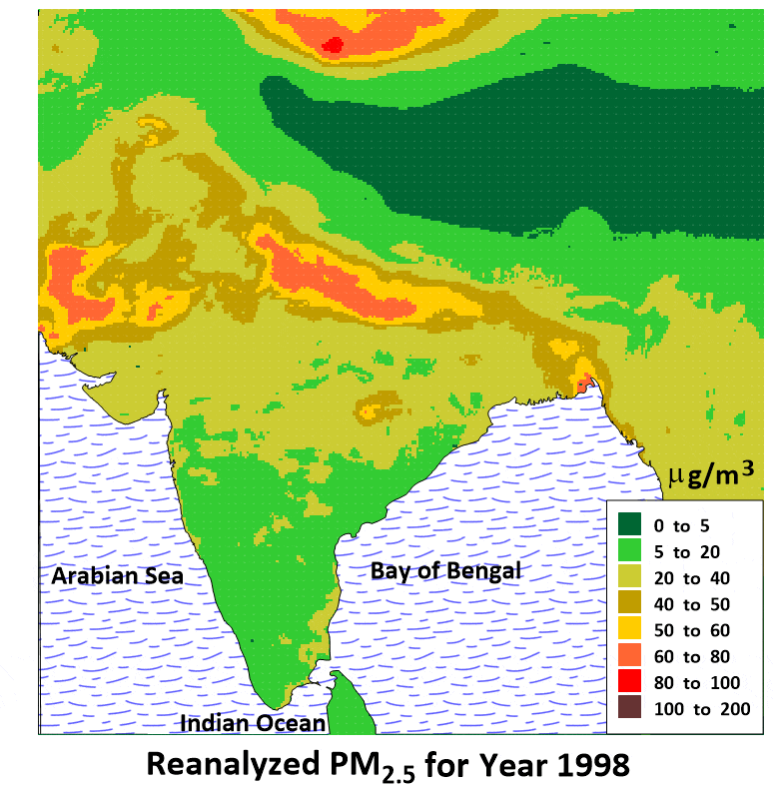
Designating Airsheds in India (Regional)
What’s in the box?

Slide 19
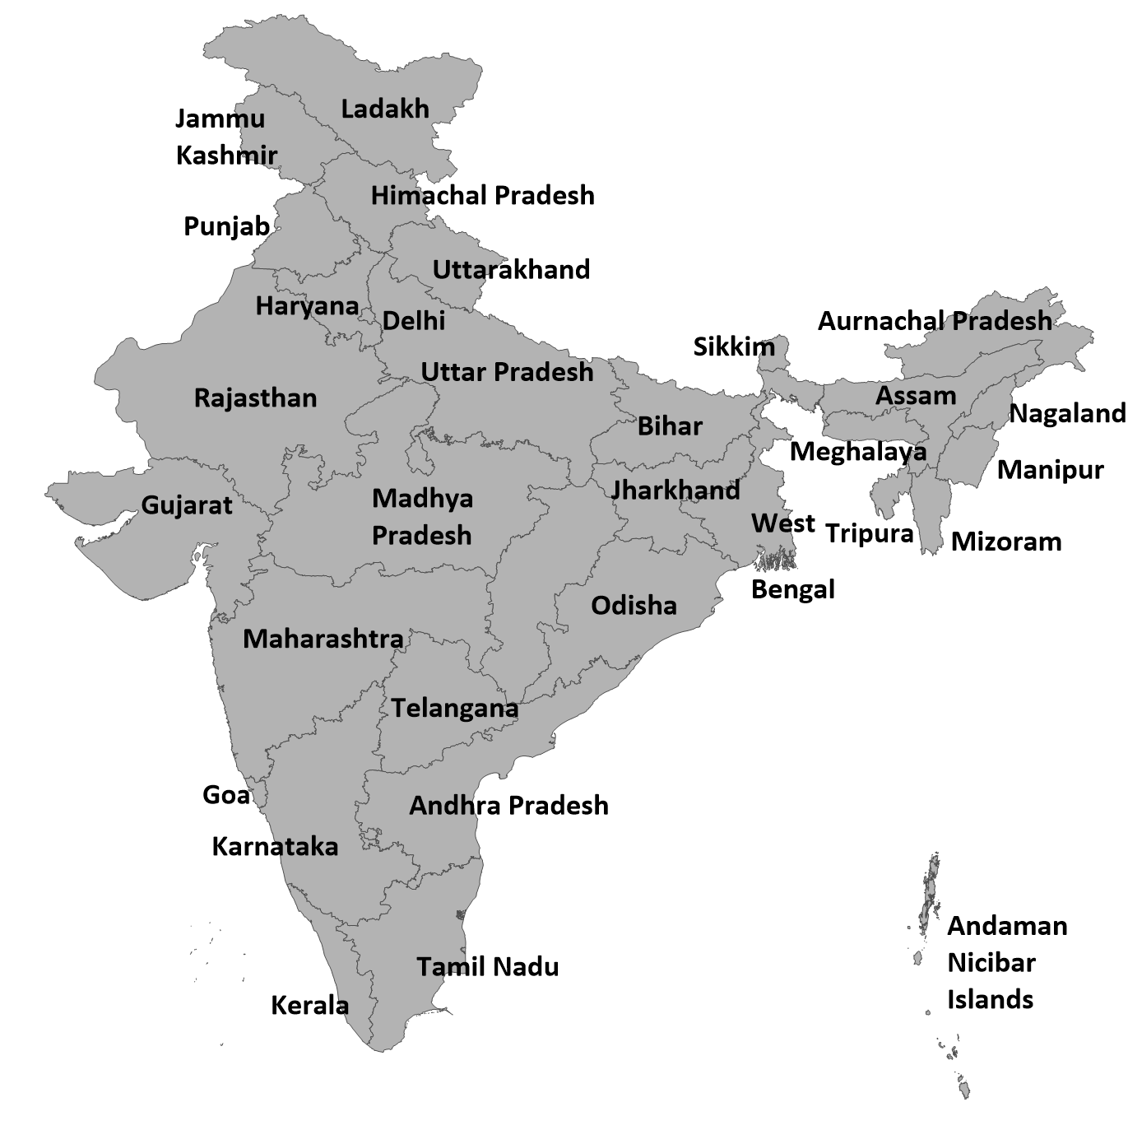
Designating Airsheds in India (Regional)
28+8
States

Slide 20
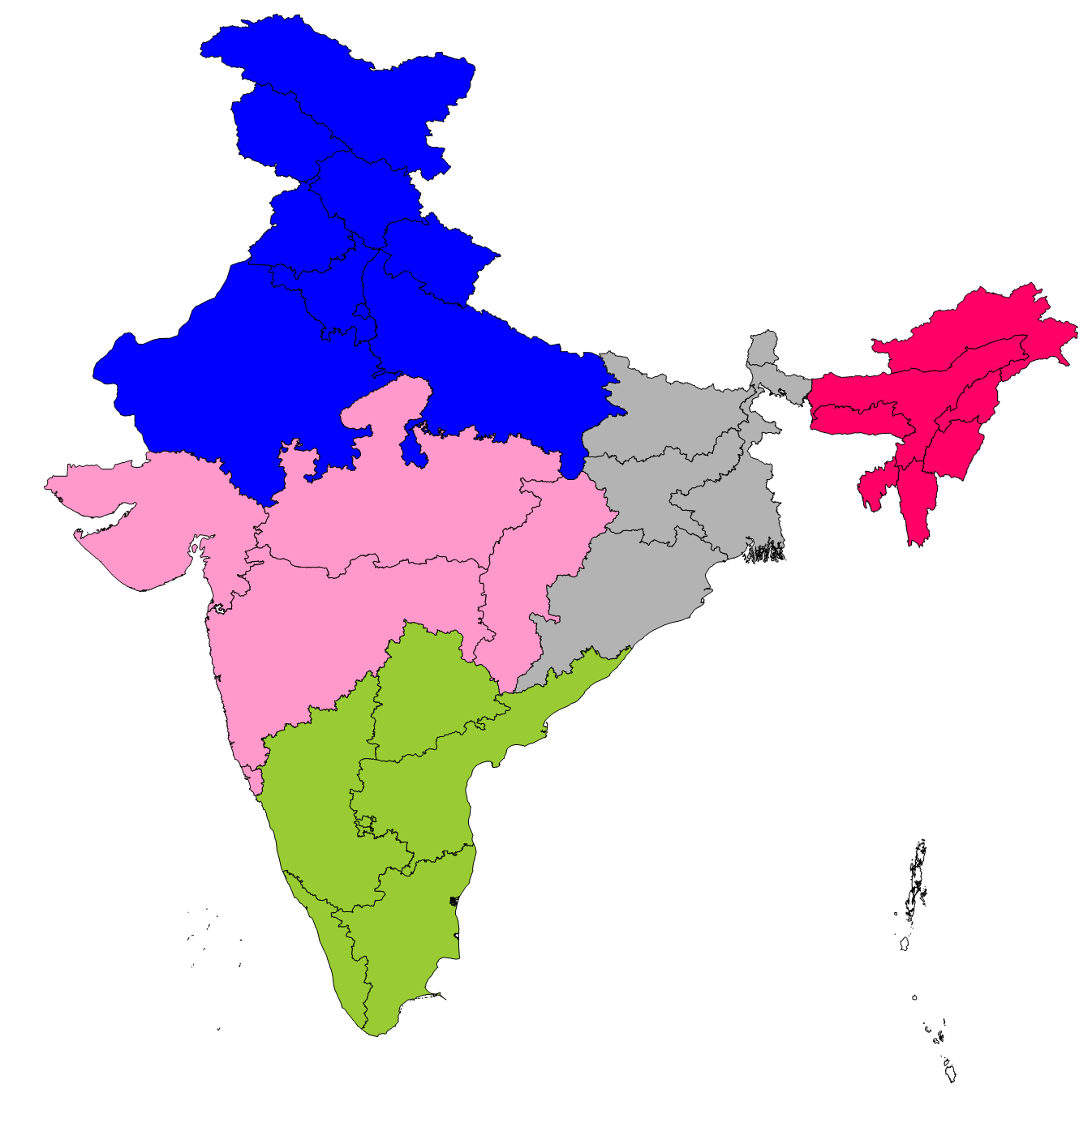
Designating Airsheds in India (Regional)
5
States
Load Dispatch Centers
Northern, Delhi
Northeastern,
Shillong
Western, Mumbai
Eastern,
Kolkata
Southern, Bengaluru

Slide 21
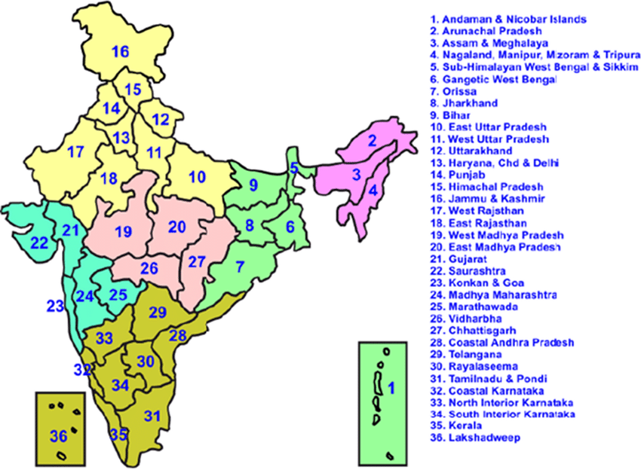
Designating Airsheds in India (Regional)
36
States
Load Dispatch Centers
Meteorology (sub-divisions)

Slide 22
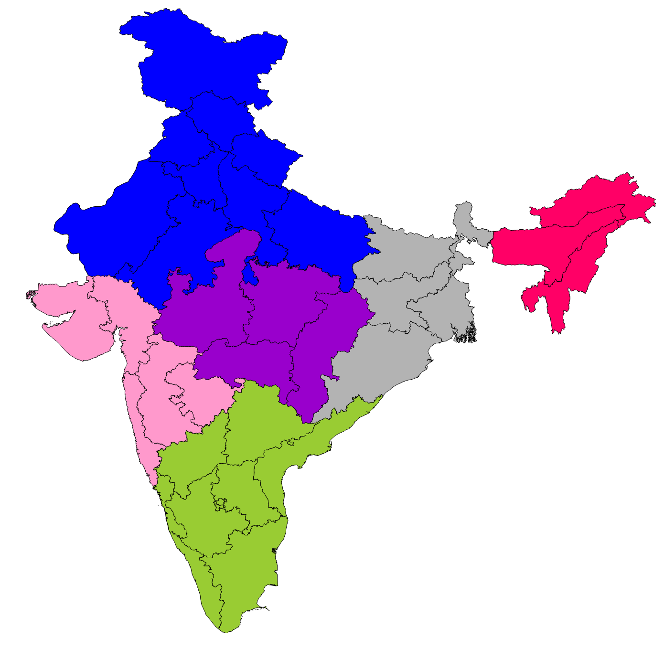
Designating Airsheds in India (Regional)
6
States
Load Dispatch Centers
Meteorology (sub-divisions)
Meteorology (reg-centers)
Northern, Delhi
Northeastern,
Guwahati
Central,
Nagpur
Western, Mumbai
Eastern,
Kolkata
Southern, Chennai

Slide 23
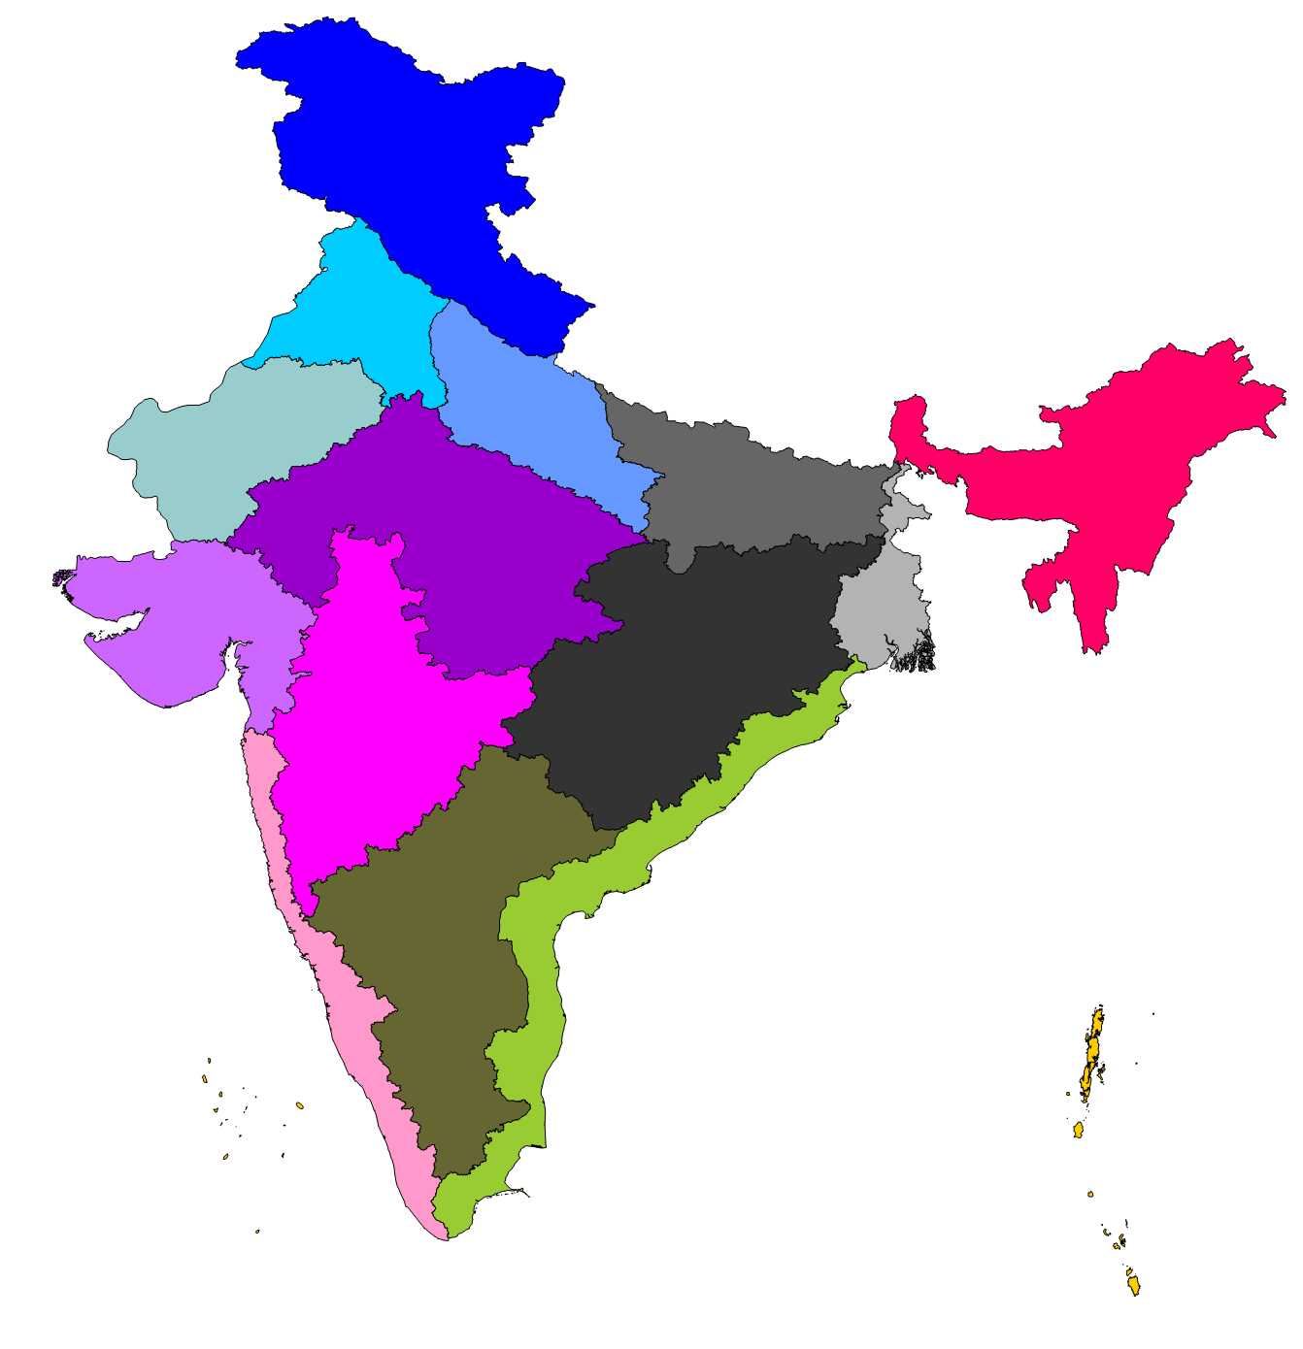
Designating Airsheds in India (Regional)
15
Western Himalayas
States
Load Dispatch Centers
Meteorology (sub-divisions)
Meteorology (reg-centers)
Agro-Climatic zones
GP= Gangetic Plains
Trans
GP
Western
Dry
Upper GP
Eastern Himalayas
Central
Plateau
Middle GP
Gujarat
Plains
Lower GP
Western
Plateau
Eastern
Plateau
East Coast
Southern
Plateau
West Coast
Islands

Slide 24
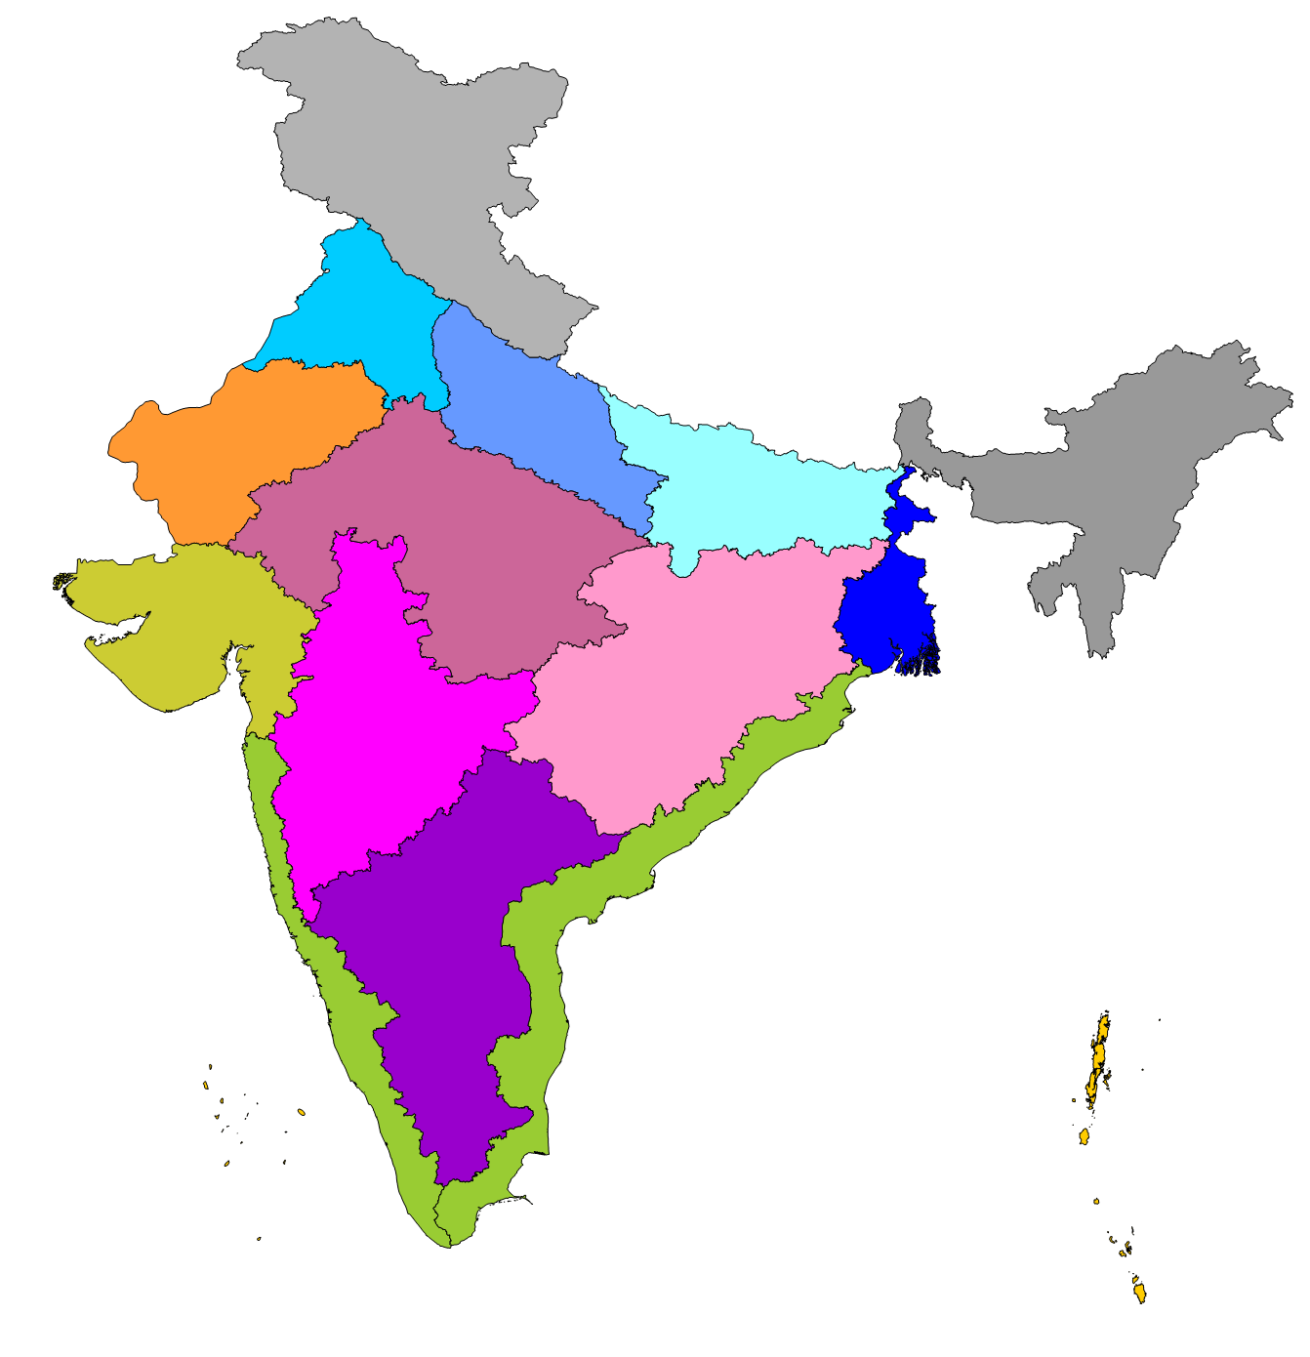
Proposed Regional Airsheds for India
1
1-2 Himalayas
3-6 Gangetic plains
7-10 Plateaus
11 Arid lands
12-14 Coastal plains
15 Islands
3
4
11
2
7
5
12
6
8
9
10
13
14
15

Slide 25
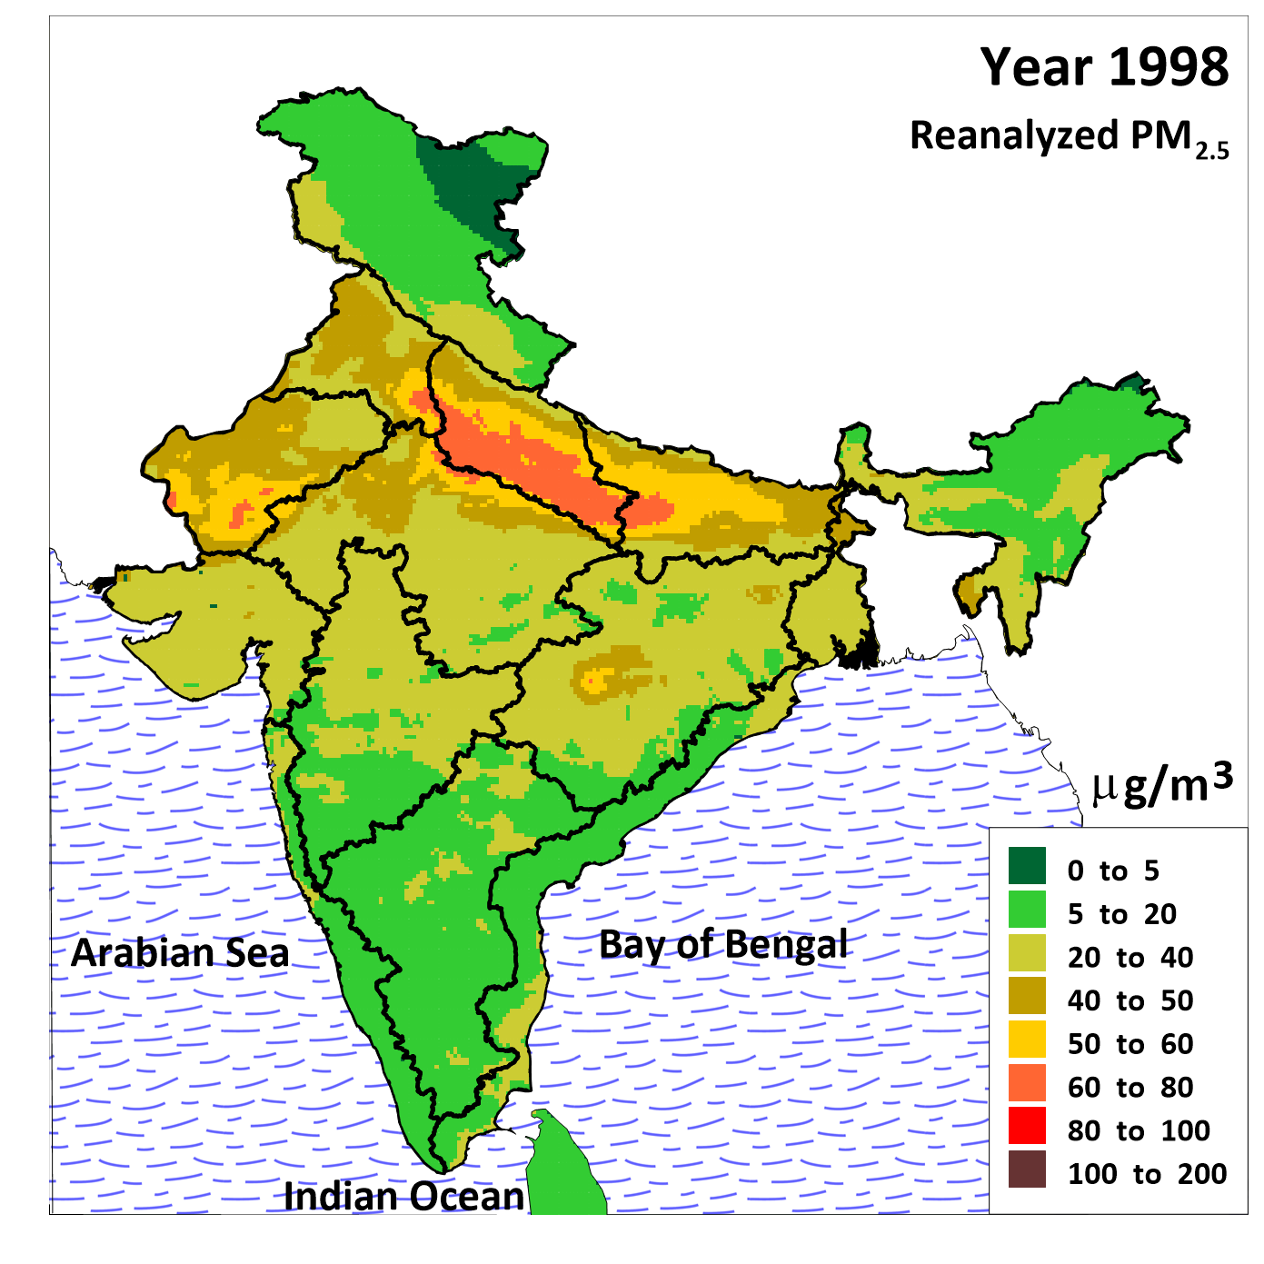
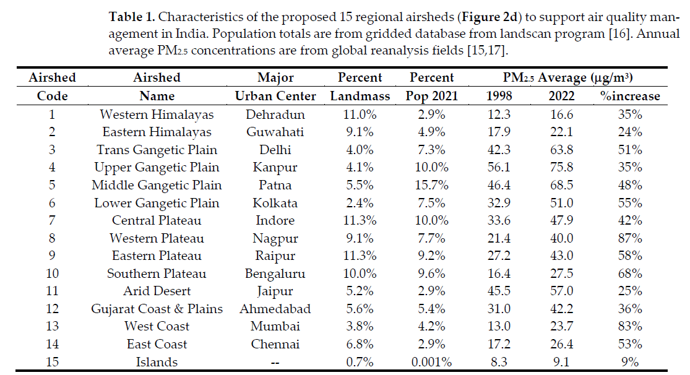
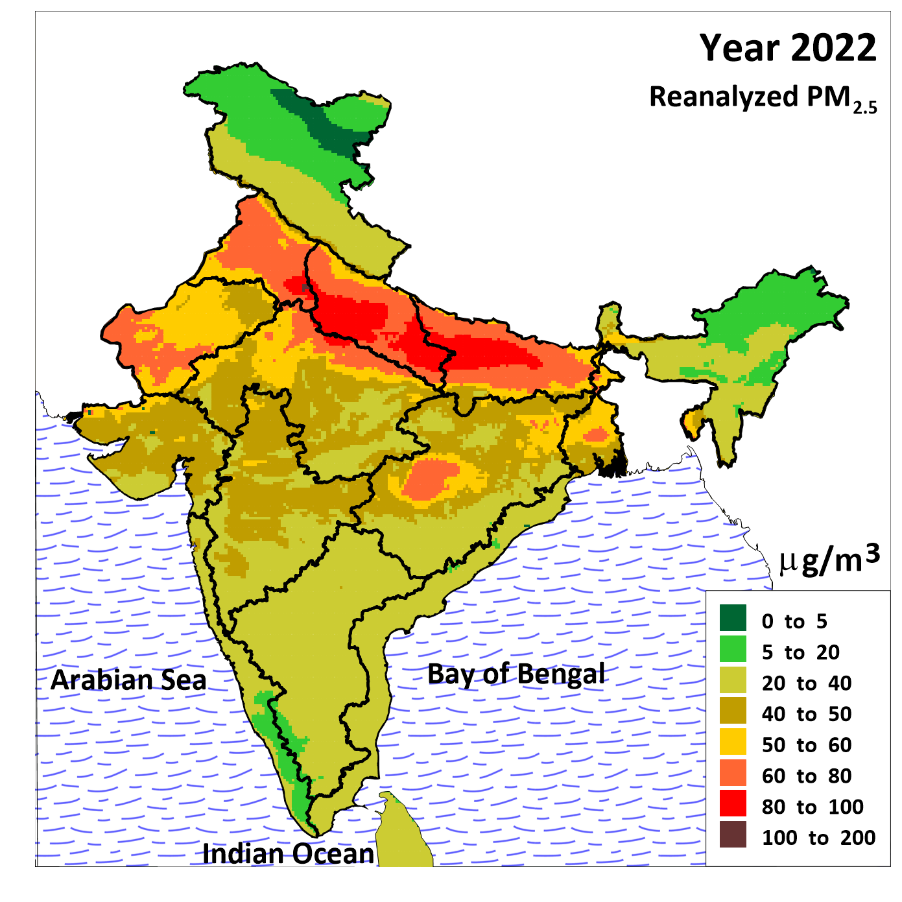
Proposed Regional Airsheds for India

Slide 26
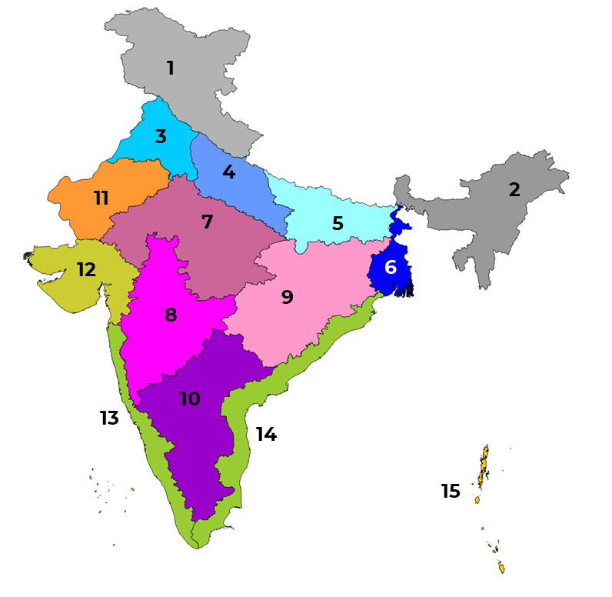
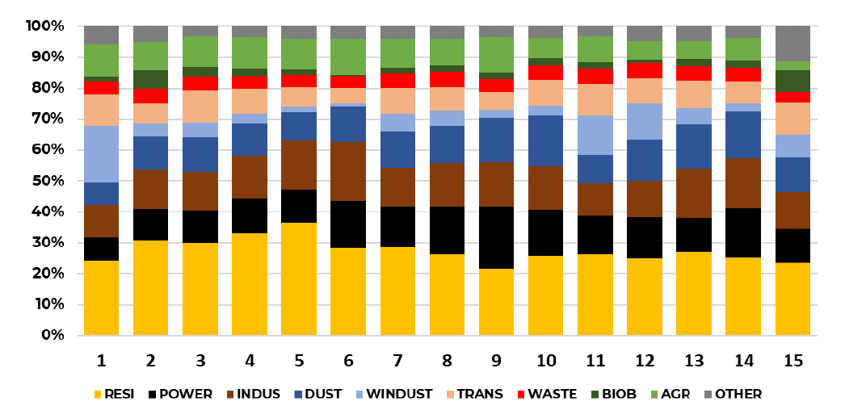
Proposed Regional Airsheds for India
WUSTL Reanalysis Source Apportionment runs

Slide 27
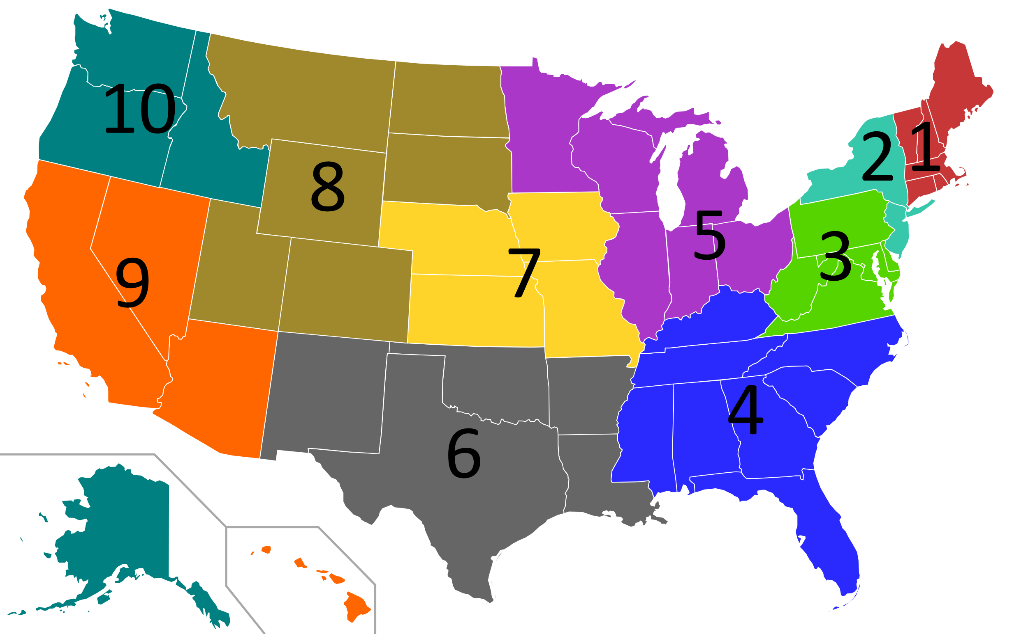
Designated Regional Airsheds (US EPA)
Region 1: Connecticut, Maine, Massachusetts, New Hampshire, Rhode Island, and Vermont (New England).
Region 2: New Jersey, New York, US territories of Puerto Rico, and the U.S. Virgin Islands.
Region 3: Delaware, Maryland, Pennsylvania, Virginia, West Virginia, and the District of Columbia.
Region 4: Alabama, Florida, Georgia, Kentucky, Mississippi, North Carolina, South Carolina, and Tennessee.
Region 5: Illinois, Indiana, Michigan, Minnesota, Ohio, and Wisconsin.
Region 6: Arkansas, Louisiana, New Mexico, Oklahoma, and Texas.
Region 7: Iowa, Kansas, Missouri, and Nebraska.
Region 8: Colorado, Montana, North Dakota, South Dakota, Utah, and Wyoming.
Region 9: Arizona, California, Hawaii, Nevada, the territories of Guam and American Samoa, and the Navajo Nation.
Region 10: Alaska, Idaho, Oregon, and Washington.

Slide 28
Proposed Regional Airsheds for India
Western Himalayas - Dehra dun
Eastern Himalayas - Guwahati
Trans Gangetic plain - Chandigarh/Delhi
Upper Gangetic plain - Kanpur
Middle Gangetic plain - Patna
Lower Gangetic plain - Kolkata
Central Plateau - Indore
Western Plateau - Nagpur
Eastern Plateau - Raipur
Southern Plateau - Bengaluru
Arid/Desert land - Jaipur
Kutch/Gujarat plain - Ahmedabad
West Coast plain - Mumbai
East Coast plain - Chennai
Islands - --
Central - Delhi

